Slide 1



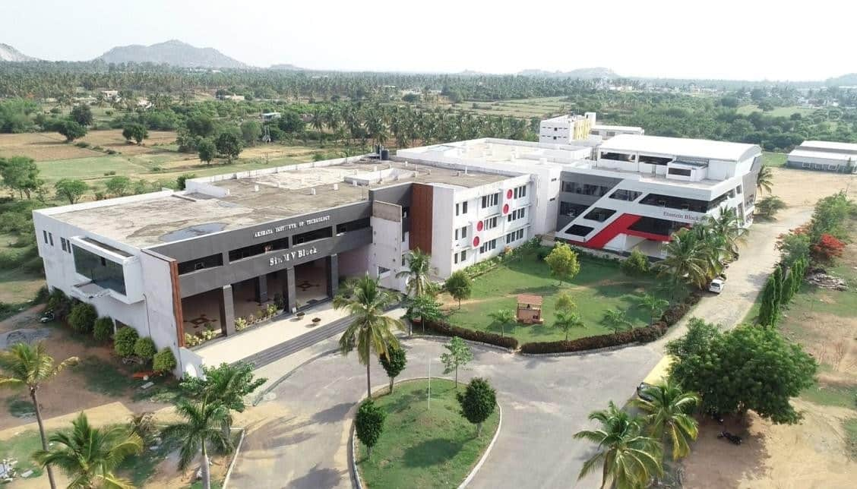
VISVESVARAYA TECHNOLOGICAL UNIVERSITY
JNANA SANGAMA, BELGAVI -590 014
Electronics Principals Circuites (BEC303)
(IPCC)
(Effective from the academic Year 2025-2026)
SEMESTER – III
Subject Code: BEC303
(Choice Based Credit System)
Prepared by:
Prof. Pradeep Kumara V H
B.E., M.Tech.
Asst. Professor. Dept. of E&CE,
AIT, Tumkur.
.
HOD
Dr. Somashekhar G C
M.Tech., Ph.D
Professor & HOD., Dept. of E&CE,
AIT, Tumkur.
Department Of Information Scienceand Engineering
Akshaya Institute of Technology
(Affiliated to VTU, Belgum& Approved by AICTE, New Delhi) Lingapura,Obalapura Post, Koratagere Road,Tumakuru-572106

Slide 2



Akshaya Institute of Technology
(Recognized by AICTE, New Delhi and Affiliated to Visvesvaraya Technological , University, Belagavi)
Akshaya Institute of Technology lingapura, Obalapura post, Koratagere Road, Tumakuru-distric- 572106, Karnataka State, INDIA.
Year: 2025 - 2026
Electronics Principals Circuites (BEC303)
(IPCCBEC303)
DEPARTMENT OF ELECTRONICSANDCOMMUNICATIONENGINEERING
(Effective from the academic Year 2025-26)
SEMESTER – III
Subject Code: BEC303
(Choice Based Credit System)
STUDENT’S NAME: ………………………………....................……....................………….
USN: …………………………………………………………….....................................................
BRANCH: …………............................................................……………………..................…..
SECTION: …………........................................ YEAR: .........................................................

Slide 3
DEPARTMENT OF ELECTRONICS AND COMMUNICATION ENGINEERING
Vision
To produce competent engineering professionals in the field of Electronics & Communincations Engineering by imparting value based quality technical education to meetthe societal needs and develop socially responsible citizens
Mission
M1: To provide strong fundamentals and technical skills in the field of Electronics and communication Engineering through effective teaching learning process.
M2: Enhancing employ ability of the students by providing skills in the fields of VLSI, Embedded systems
M3: Encourage the students to participate in co curricular and extra curricular activities that creates a spirit of social responsibility and leadership qualities.
AIT, Tumakuru.

Slide 4
Program Outcomes
Sl. No. | Description | POs
1 | Engineering knowledge: Apply the knowledge of mathematics, science, engineering fundamentals, and computer science and business systems to the solution of complex engineering and societal problems. | PO1
2 | Problem analysis: Identify, formulate, review research literature, and analyze complex engineering and business problems reaching substantiated conclusions using first principles of mathematics, natural sciences, and engineering sciences. | PO2
3 | Design/development of solutions: Design solutions for complex engineering problems and design system components or processes that meet the specified needs with appropriate consideration for the public health and safety, and the cultural, societal, and environmental considerations. | PO3
4 | Conduct investigations of complex problems: Use research-based knowledge and research methods including design of experiments, analysis and interpretation of data, and synthesis of the information to provide valid conclusions. | PO4
5 | Modern tool usage: Create, select, and apply appropriate techniques, resources, and modern engineering and IT tools including prediction and modeling to complex engineering activities with an understanding of the limitations | PO5
6 | The engineer and society: Apply reasoning informed by the contextual knowledge to assess societal, health, safety, legal and cultural issues and the consequent responsibilities relevant to the professional engineering and business practices. | PO6
7 | Environment and sustainability: Understand the impact of the professional engineering solutions in business societal and environmental contexts, and demonstrate the knowledge of, and need for sustainable development. | PO7
8 | Ethics: Apply ethical principles and commit to professional ethics and responsibilities and norms of the engineering and business practices. | PO8
9 | Individual and team work: Function effectively as an individual, and as a member or leader in diverse teams, and in multidisciplinary settings. | PO9
10 | Communication: Communicate effectively on complex engineering activities with the engineering community and with society at large, such as, being able to comprehend and write effective reports and design documentation, make effective presentations, and give and receive clear instructions. | PO10
11 | Project management and finance: Demonstrate knowledge and understanding of the engineering, business and management principles and apply these to one’s own work, as a member and leader in a team, to manage projects and in multidisciplinary environments. | PO11
12 | Life-long learning: Recognize the need for, and have the preparation and ability to engage in independent and life-long learning in the broadest context of technological change. | PO12
AIT, Tumakuru.

Slide 5
13.09.2023
Electronic Principles and Circuits |  | Semester | 3
Course Code | BEC303 | CIE Marks | 50
Teaching Hours/Week (L:T:P: S) | 3:0:2 | SEE Marks | 50
Total Hours of Pedagogy | 40 hours Theory + 8-10 Lab slots | Total Marks | 100
Credits | 04 | Exam Hours | 3
Examination nature (SEE) | Theory/Practical
Course objectives: This course will enable students to Design and analyse the BJT circuits as an amplifier and voltage regulation. Design of MOSFET Amplifiers and analyse the basic amplifier configurations using small signal equivalent circuit models Design of operational amplifiers circuits as Comparators, DAC and filters. Understand the concept of positive and negative feedback. Analyze Power amplifier circuits in different modes of operation. Construct Feedback and Oscillator circuits using FET. Understand the thyristor operation and the different types of thyristors.
Teaching-Learning Process (General Instructions) These are sample Strategies, which teacher can use to accelerate the attainment of the various course outcomes. Lecture method (L) does not mean only traditional lecture method, but different type of teaching methods may be adopted to develop the outcomes. Show Video/animation films to explain evolution of communication technologies. Encourage collaborative (Group) Learning in the class Ask at least three HOTS (Higher order Thinking) questions in the class, which promotes critical thinking Adopt Problem Based Learning (PBL), which fosters students’ Analytical skills, develop thinking skills such as the ability to evaluate, generalize, and analyze information rather than simply recall it. Show the different ways to solve the same problem and encourage the students to come up with their own creative ways to solve them. Discuss how every concept can be applied to the real world - and when that's possible, it helps improve the students' understanding.
MODULE-1
BJT AC models: Base Biased Amplifier, Emitter Biased Amplifier, Small Signal Operation, AC Beta, AC Resistance of the emitter diode, Two transistor models, Analyzing an amplifier. Voltage Amplifiers: Voltage gain, Multistage Amplifiers. CC and CB Amplifiers: CC Amplifier, Output Impedance, Cascading CE and CC, Darlington Connections, Voltage regulation, The Common base Amplifier. [Text1]
MODULE-2
Downloaded by Pradeep V H (pradeepait2024@gmail.com)

Slide 6
13.09.2023
MOSFET Biasing in MOS amplifier circuits: Fixing VGS, Fixing VG, Drain to Gate feedback resistor. Small signal operation and modelling: The DC bias point, signal current in drain, voltage gain, small signal equivalent circuit models, transconductance, The T equivalent circuit model. MOSFET Amplifier configuration: Basic configurations, characterizing amplifiers, CS amplifier with and without source resistance, The Common Gate Amplifier, Source follower.
MODULE-3
Linear Opamp Circuits: Summing Amplifier and D/A Converter, Nonlinear Op-amp Circuits: Comparator with zero reference, Comparator with non-zero references. Comparator with Hysteresis. Oscillator: Theory of Sinusoidal Oscillation, The Wein-Bridge Oscillator, RC Phase Shift Oscillator, The Colpitts Oscillator, Hartley Oscillator, Crystal Oscillator. The 555 timer: Monostable Operation, Astable Operation. [Text1]
MODULE-4
Negative Feedback: Four Types of Negative Feedback, VCVS Voltage gain, Other VCVS Equations, ICVS Amplifier, VCIS Amplifier, ICIS Amplifier (No Mathematical Derivation). Active Filters: Ideal Responses, First Order Stages, VCVS Unity Gain Second Order Low pass Filters, VCVS Equal Component Low Pass Filters, VCVS High Pass Filters, MFB Bandpass Filters, Bandstop Filters. [Text1]
MODULE-5
Power Amplifiers: Amplifier terms, Two load lines, Class A Operation, Class B operation, Class B push pull emitter follower, Class C Operation. Thyristors: The four layer Diode, SCR, SCR Phase control, Bidirectional Thyristors, IGBTs, Other Thyristors. [Text1]
Downloaded by Pradeep V H (pradeepait2024@gmail.com)

Slide 7
13.09.2023
PRACTICAL COMPONENT OF IPCC (Experiments can be conducted either using any circuit simulation software or discrete components)
Sl.NO | Experiments
1 | Design and Test Bridge Rectifier with Capacitor Input Filter Zener voltage regulator
2 | Design and Test Biased Clippers – a)Positive, b) Negative , c) Positive-Negative Positive and Negative Clampers with and without Reference.
3 | Plot the transfer and drain characteristics of a JFET and calculate its drain resistance, mutual conductance and amplification factor.
4 | Plot the transfer and drain characteristics of n-channel MOSFET and calculate its parameters, namely; drain resistance, mutual conductance and amplification factor.
5 | Design and test (i) Emitter Follower , (ii) Darlington Connection
6 | Design and plot the frequency response of Common Source JFET/MOSFET amplifier
7 | Test the Opamp Comparator with zero and non zero reference and obtain the Hysteresis curve.
8 | Design and test Full wave Controlled rectifier using RC triggering circuit.
9 | Design and test Precision Half wave and full wave rectifiers using Opamp
10 | Design and test RC phase shift oscillator
Course outcomes (Course Skill Set): At the end of the course, the student will be able to: Understand the characteristics of BJTs and FETs for switching and amplifier circuits. Design and analyze amplifiers and oscillators with different circuit configurations and biasing conditions. Understand the feedback topologies and approximations in the design of amplifiers and oscillators. Design of circuits using linear ICs for wide range applications such as ADC, DAC, filters and timers. Understand the power electronic device components and its functions for basic power electronic circuits.
Assessment Details (both CIE and SEE) The weightage of Continuous Internal Evaluation (CIE) is 50% and for Semester End Exam (SEE) is 50%. The minimum passing mark for the CIE is 40% of the maximum marks (20 marks out of 50) and for the SEE minimum passing mark is 35% of the maximum marks (18 out of 50 marks). The student is declared as a pass in the course if he/she secures a minimum of 40% (40 marks out of 100) in the sum total of the CIE (Continuous Internal Evaluation) and SEE (Semester End Examination) taken together. The IPCC means the practical portion integrated with the theory of the course. CIE marks for the theory component are 25 marks and that for the practical component is 25 marks. CIE for the theory component of the IPCC 25 marks for the theory component are split into 15 marks for two Internal Assessment Tests (Two Tests, each of 15 Marks with 01-hour duration, are to be conducted) and 10 marks for other assessment methods mentioned in 22OB4.2. The first test at the end of 40-50% coverage of the syllabus and the second test after covering 85-90% of the syllabus.
Downloaded by Pradeep V H (pradeepait2024@gmail.com)

Slide 8
13.09.2023
Scaled-down marks of the sum of two tests and other assessment methods will be CIE marks for the theory component of IPCC (that is for 25 marks).
The student has to secure 40% of 25 marks to qualify in the CIE of the theory component of IPCC.
CIE for the practical component of the IPCC
15 marks for the conduction of the experiment and preparation of laboratory record, and 10 marks for the test to be conducted after the completion of all the laboratory sessions.
On completion of every experiment/program in the laboratory, the students shall be evaluated including viva- voce and marks shall be awarded on the same day.
The CIE marks awarded in the case of the Practical component shall be based on the continuous evaluation of the laboratory report. Each experiment report can be evaluated for 10 marks. Marks of all experiments’ write- ups are added and scaled down to 15 marks.
The laboratory test (duration 02/03 hours) after completion of all the experiments shall be conducted for 50 marks and scaled down to 10 marks.
Scaled-down marks of write-up evaluations and tests added will be CIE marks for the laboratory component of IPCC for 25 marks.
The student has to secure 40% of 25 marks to qualify in the CIE of the practical component of the IPCC.
SEE for IPCC
Theory SEE will be conducted by University as per the scheduled timetable, with common question papers for the
course (duration 03 hours)
The question paper will have ten questions. Each question is set for 20 marks.
There will be 2 questions from each module. Each of the two questions under a module (with a maximum of 3 sub-questions), should have a mix of topics under that module.
The students have to answer 5 full questions, selecting one full question from each module.
Marks scored by the student shall be proportionally scaled down to 50 Marks
The theory portion of the IPCC shall be for both CIE and SEE, whereas the practical portion will have a CIE component only. Questions mentioned in the SEE paper may include questions from the practical component.
The minimum marks to be secured in CIE to appear for SEE shall be 10 (40% of maximum marks-25) in the theory component and 10 (40% of maximum marks -25) in the practical component. The laboratory
component of the IPCC shall be for CIE only. However, in SEE, the questions from the laboratory component shall be included. The maximum of 04/05 sub-questions are to be set from the practical
component of IPCC, the total marks of all questions should not be more than 20 marks.
SEE will be conducted for 100 marks and students shall secure 35% of the maximum marks to qualify for the SEE. Marks secured will be scaled down to 50.
The student is declared as a pass in the course if he/she secures a minimum of 40% (40 marks out of 100) in the sum total of the CIE (Continuous Internal Evaluation) and SEE (Semester End Examination) taken together.
Downloaded by Pradeep V H (pradeepait2024@gmail.com)

Slide 9
13.09.2023
Suggested Learning Resources: Books Albert Malvino, David J Bates, Electronic Principles, 7th Edition, Mc Graw Hill Education, 2017, ISBN:978-0- 07-063424-4. Microelectronic Circuits, Theory and Applications, Adel S Sedra, Kenneth C Smith, 6thEdition, Oxford, 2015.ISBN:978-0-19-808913-1
Web links and Video Lectures (e-Resources): Integrated Electronics: Analog and Digital Circuits and Systems, Jacob Millman, Christos C. Halkias, McGraw-Hill, 2015. Electronic Devices and Circuit, Boylestad & Nashelsky, Eleventh Edition, Pearson, January 2015.
Activity Based Learning (Suggested Activities in Class)/ Practical Based learning
Downloaded by Pradeep V H (pradeepait2024@gmail.com)

Slide 10
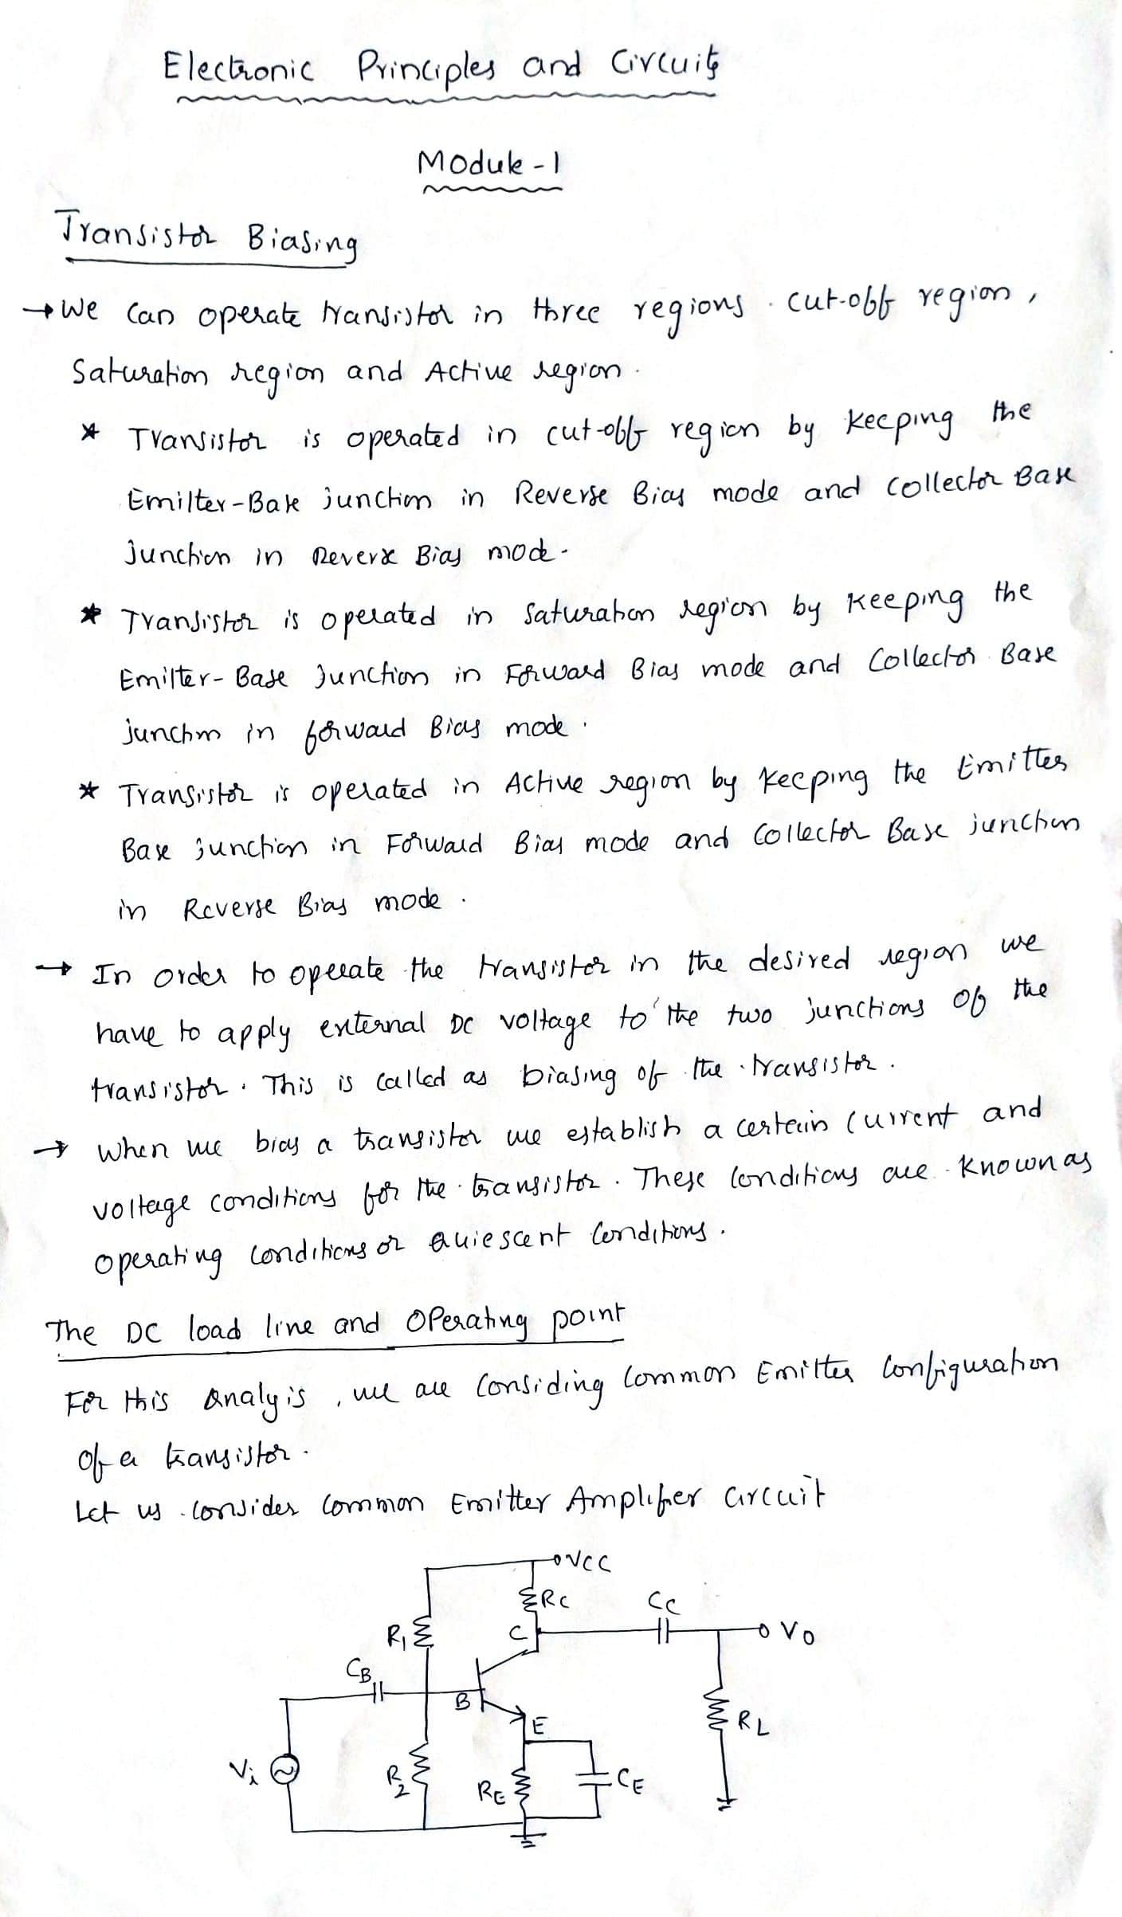

Slide 11
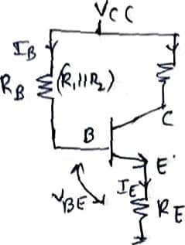

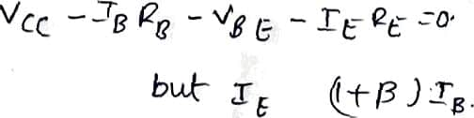
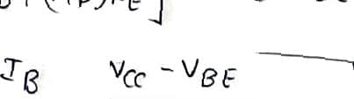



’”4 O I.f\ Či Ł Curt ,

Slide 12
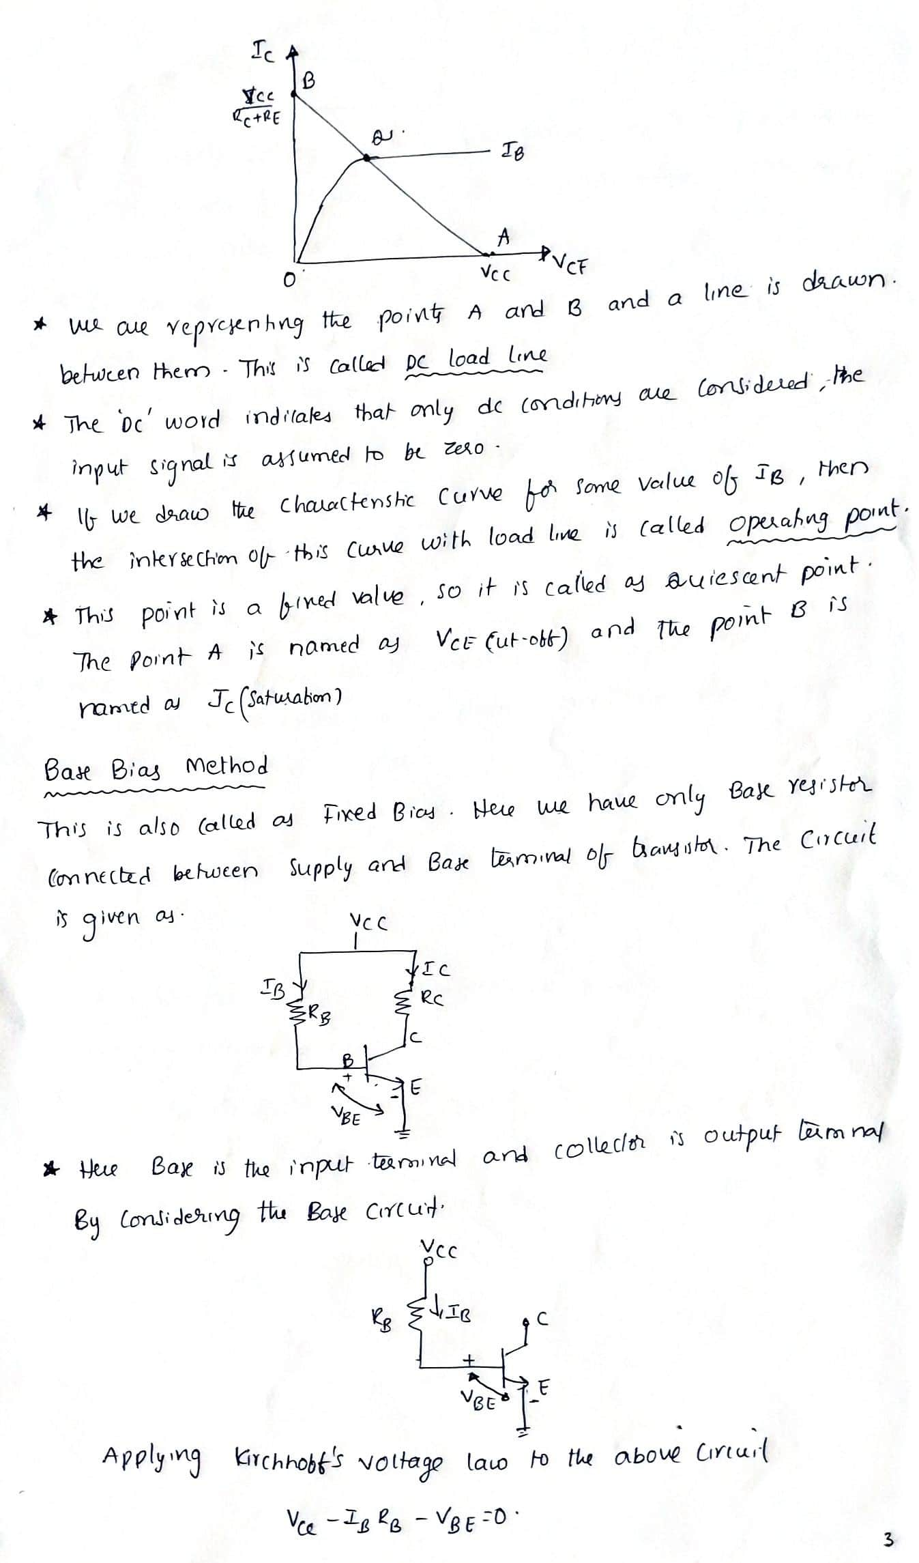

Slide 13
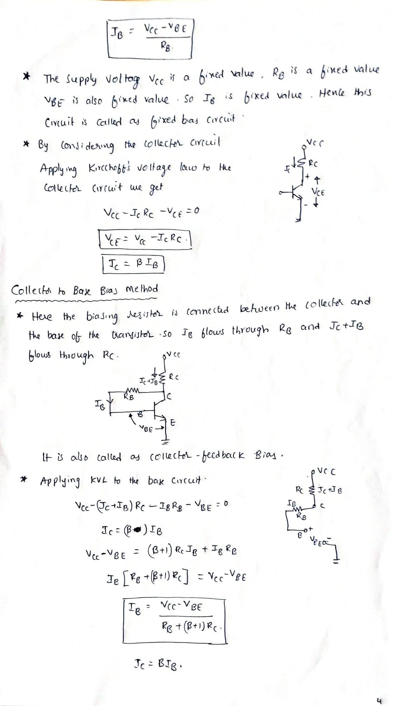

Slide 14
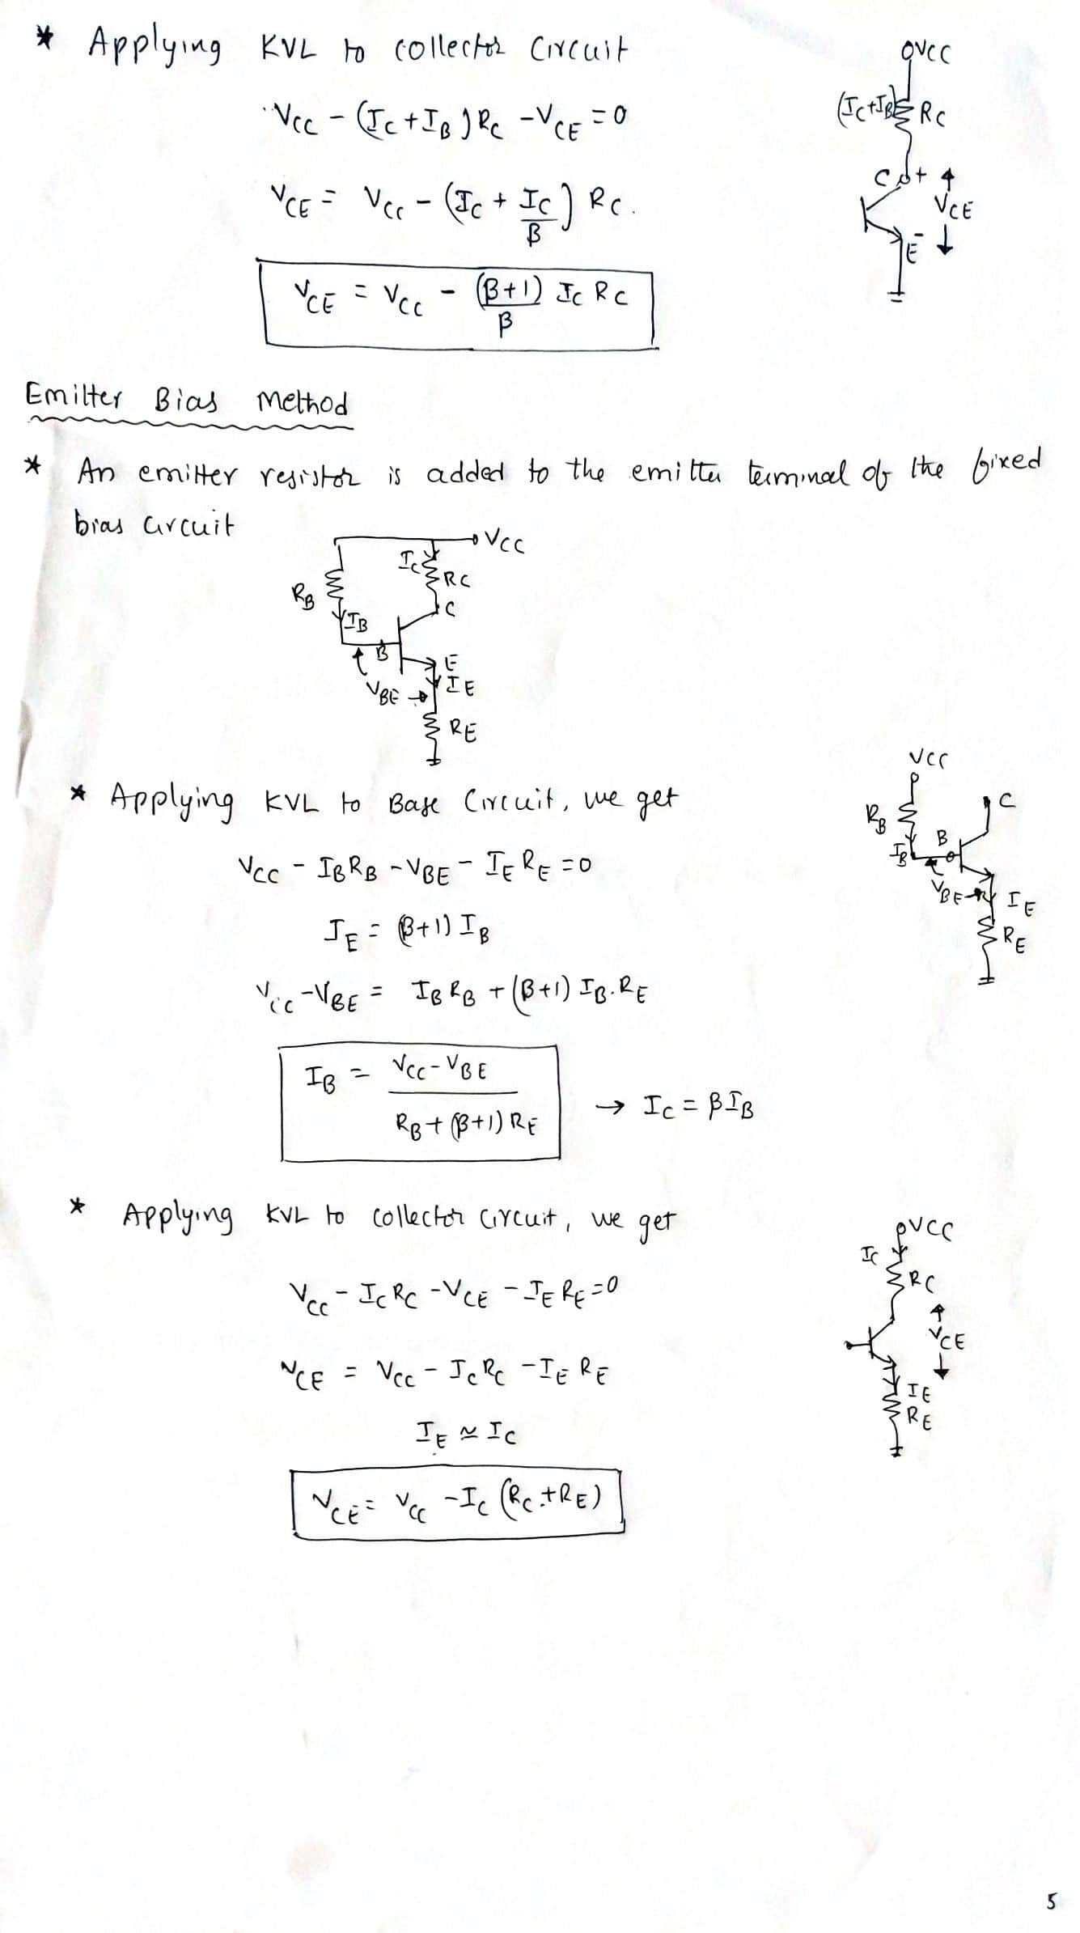

Slide 15
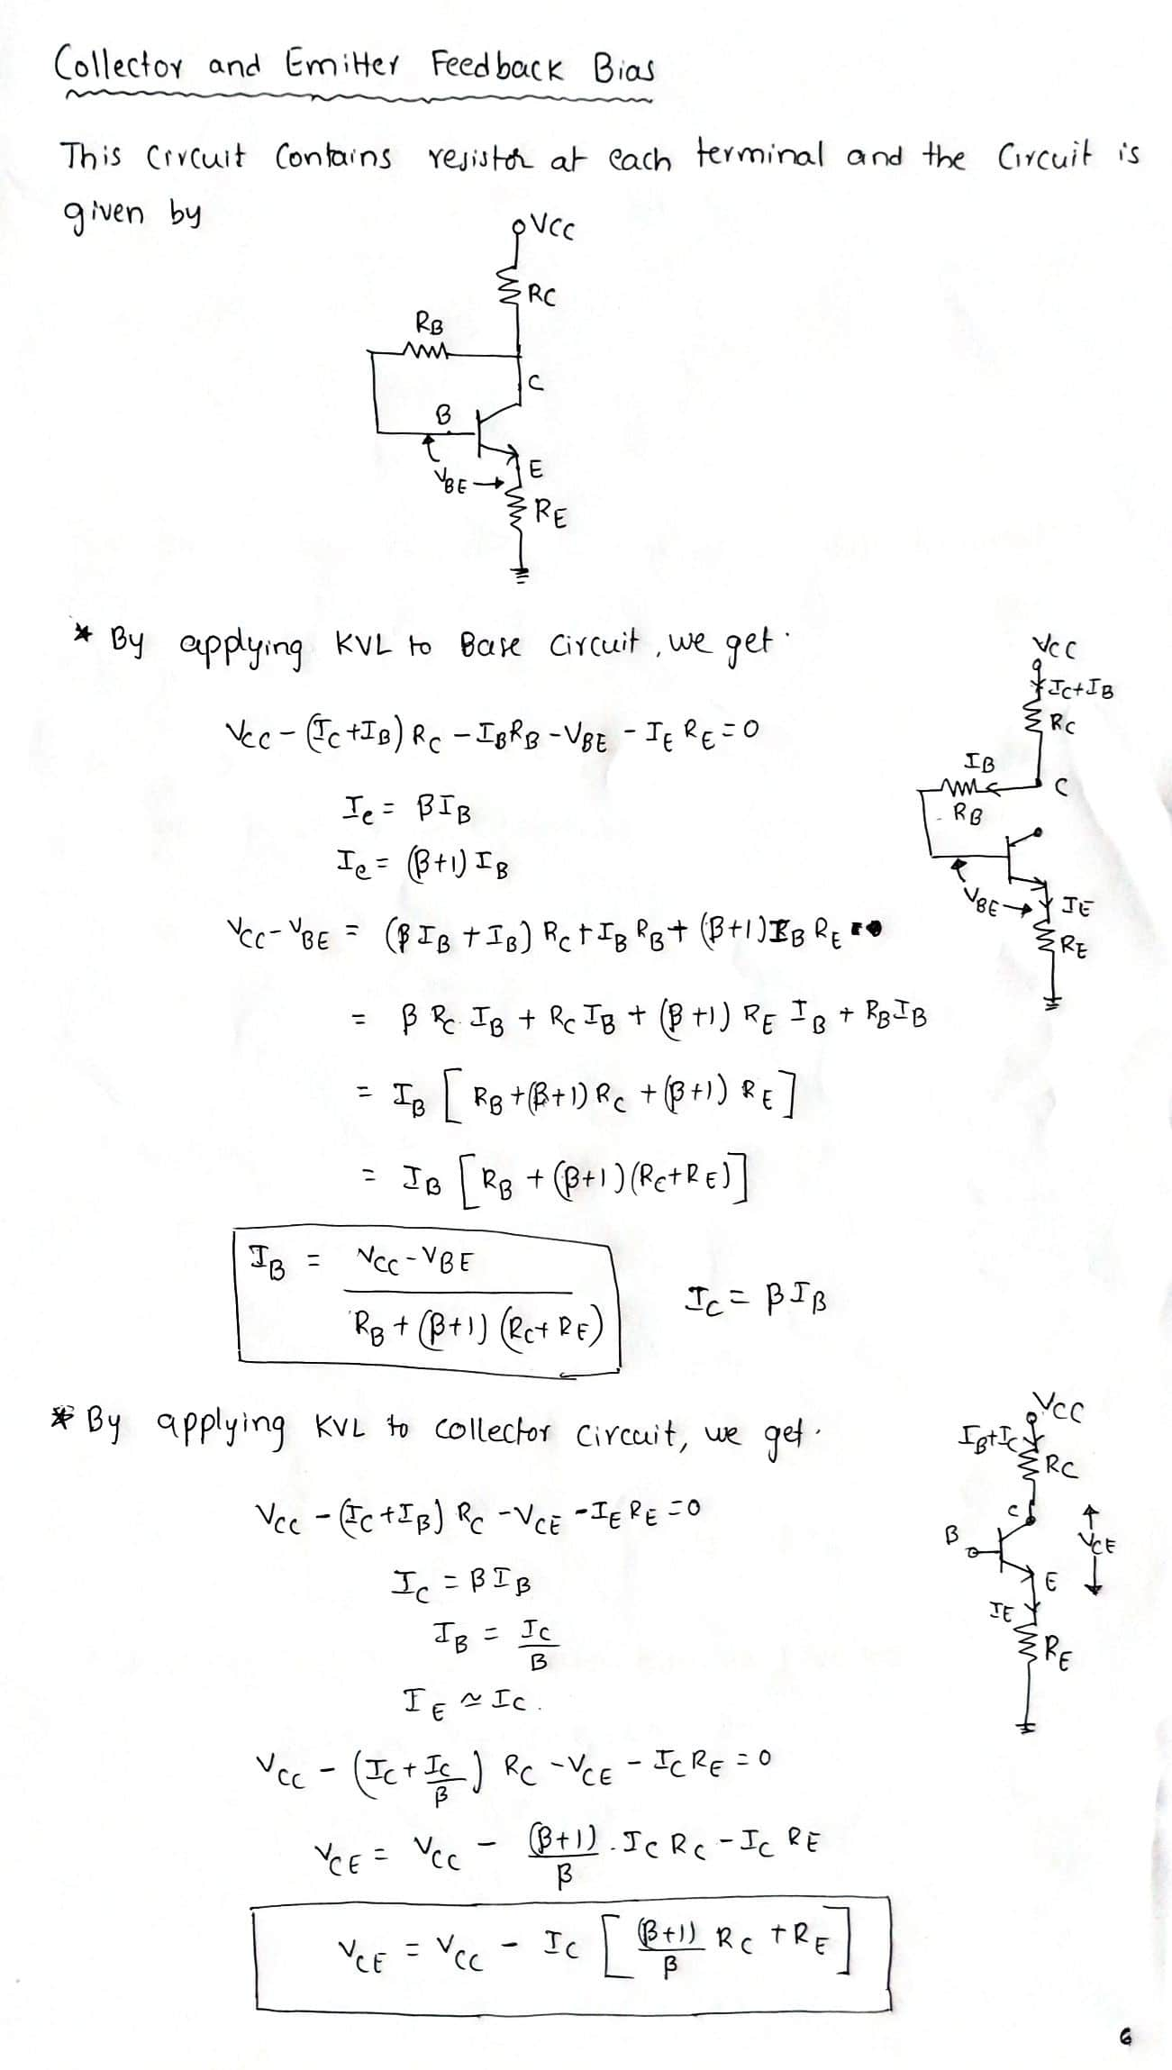

Slide 16
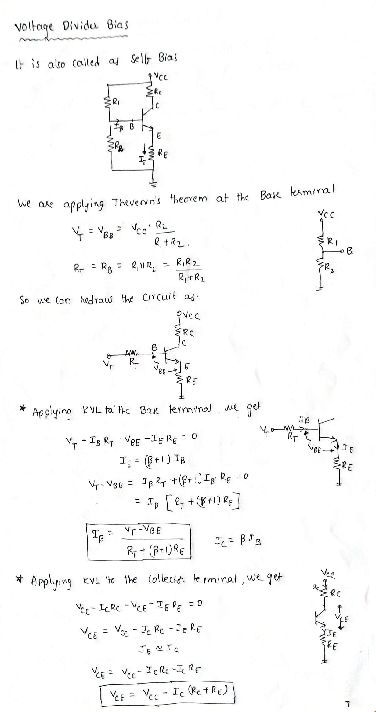

Slide 17
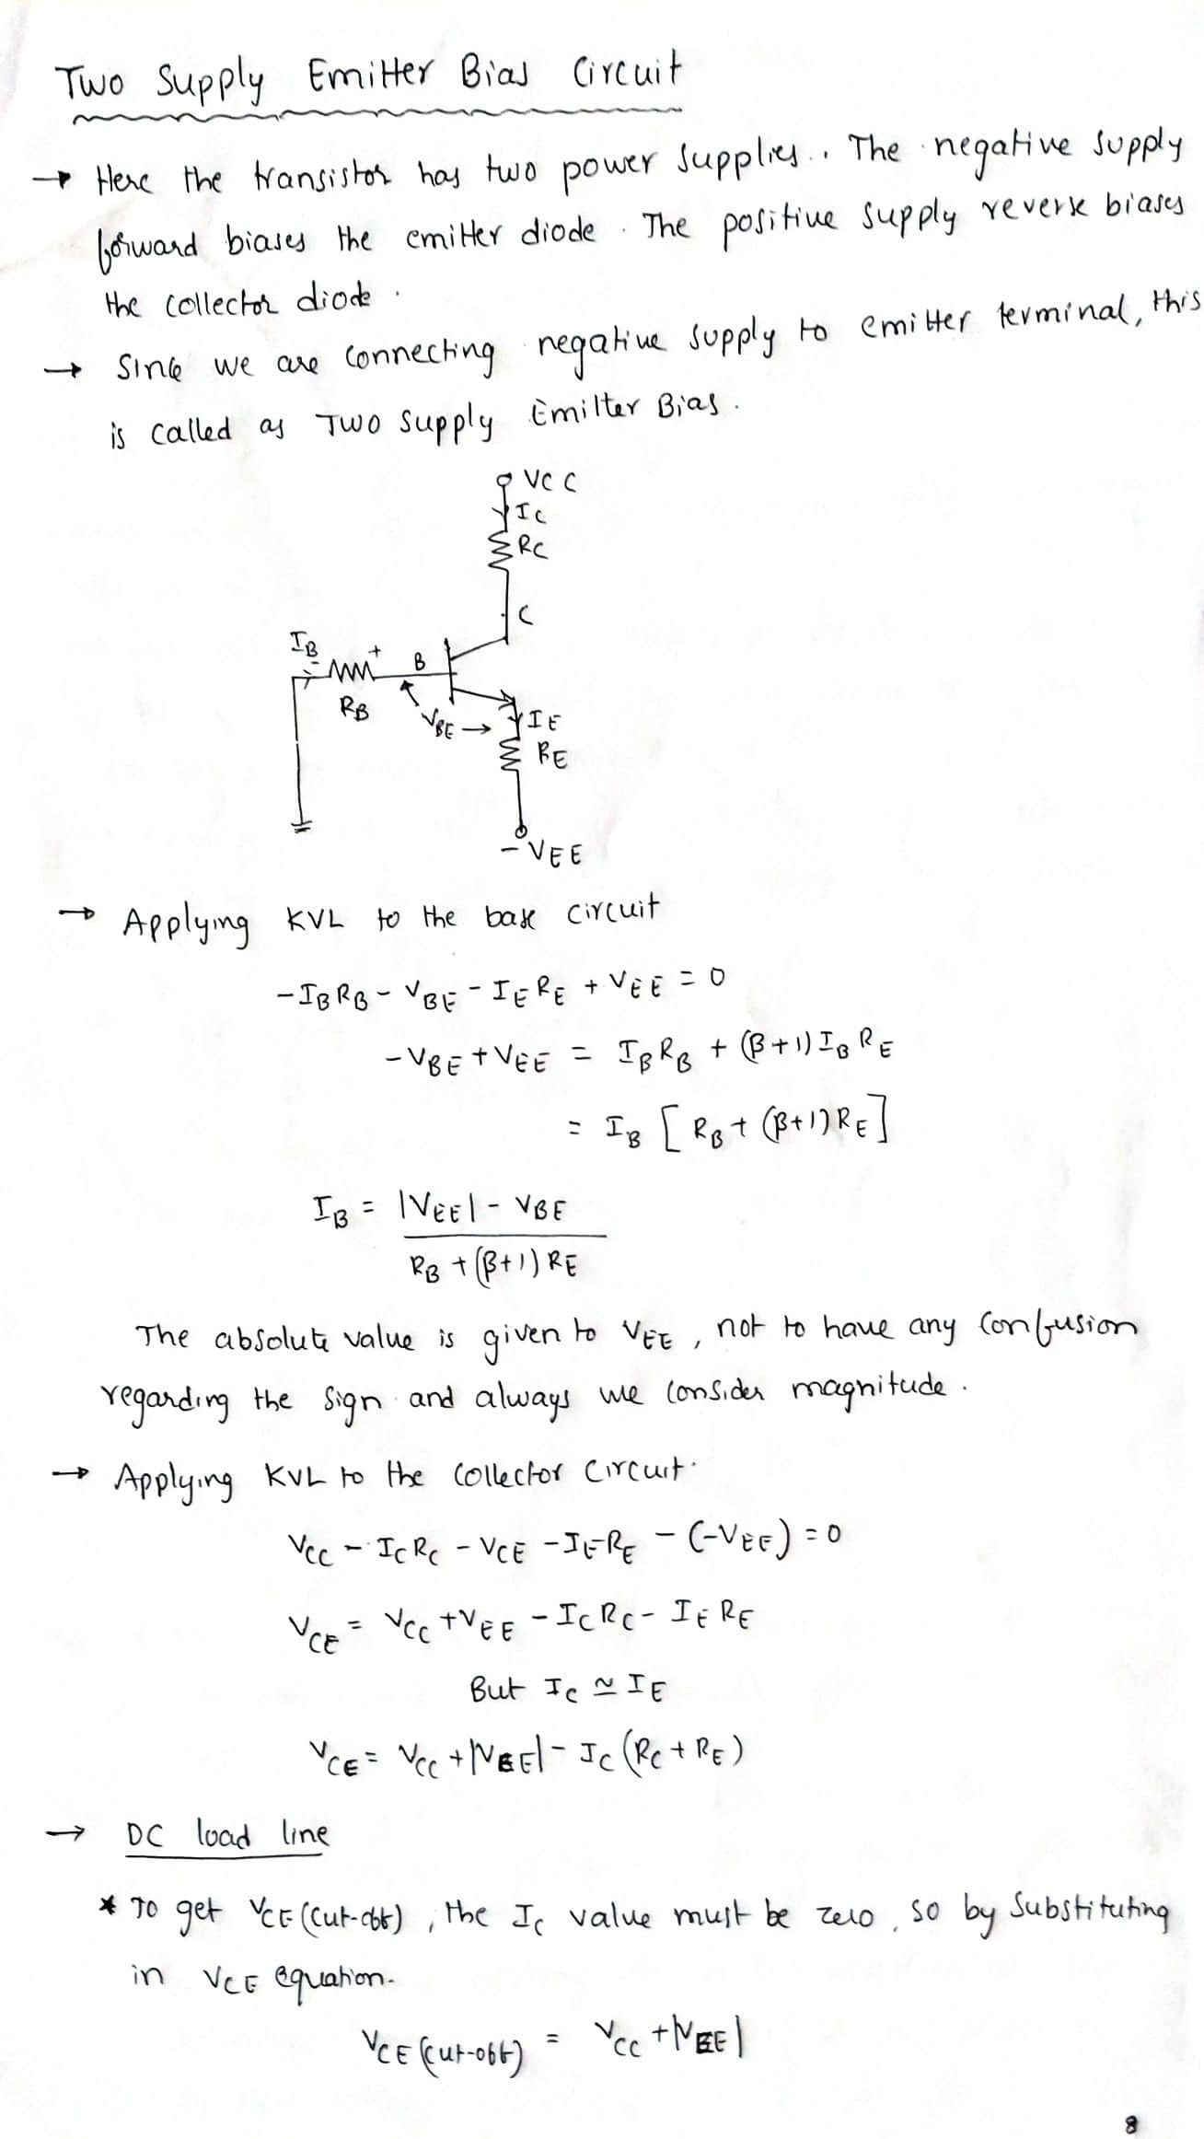

Slide 18
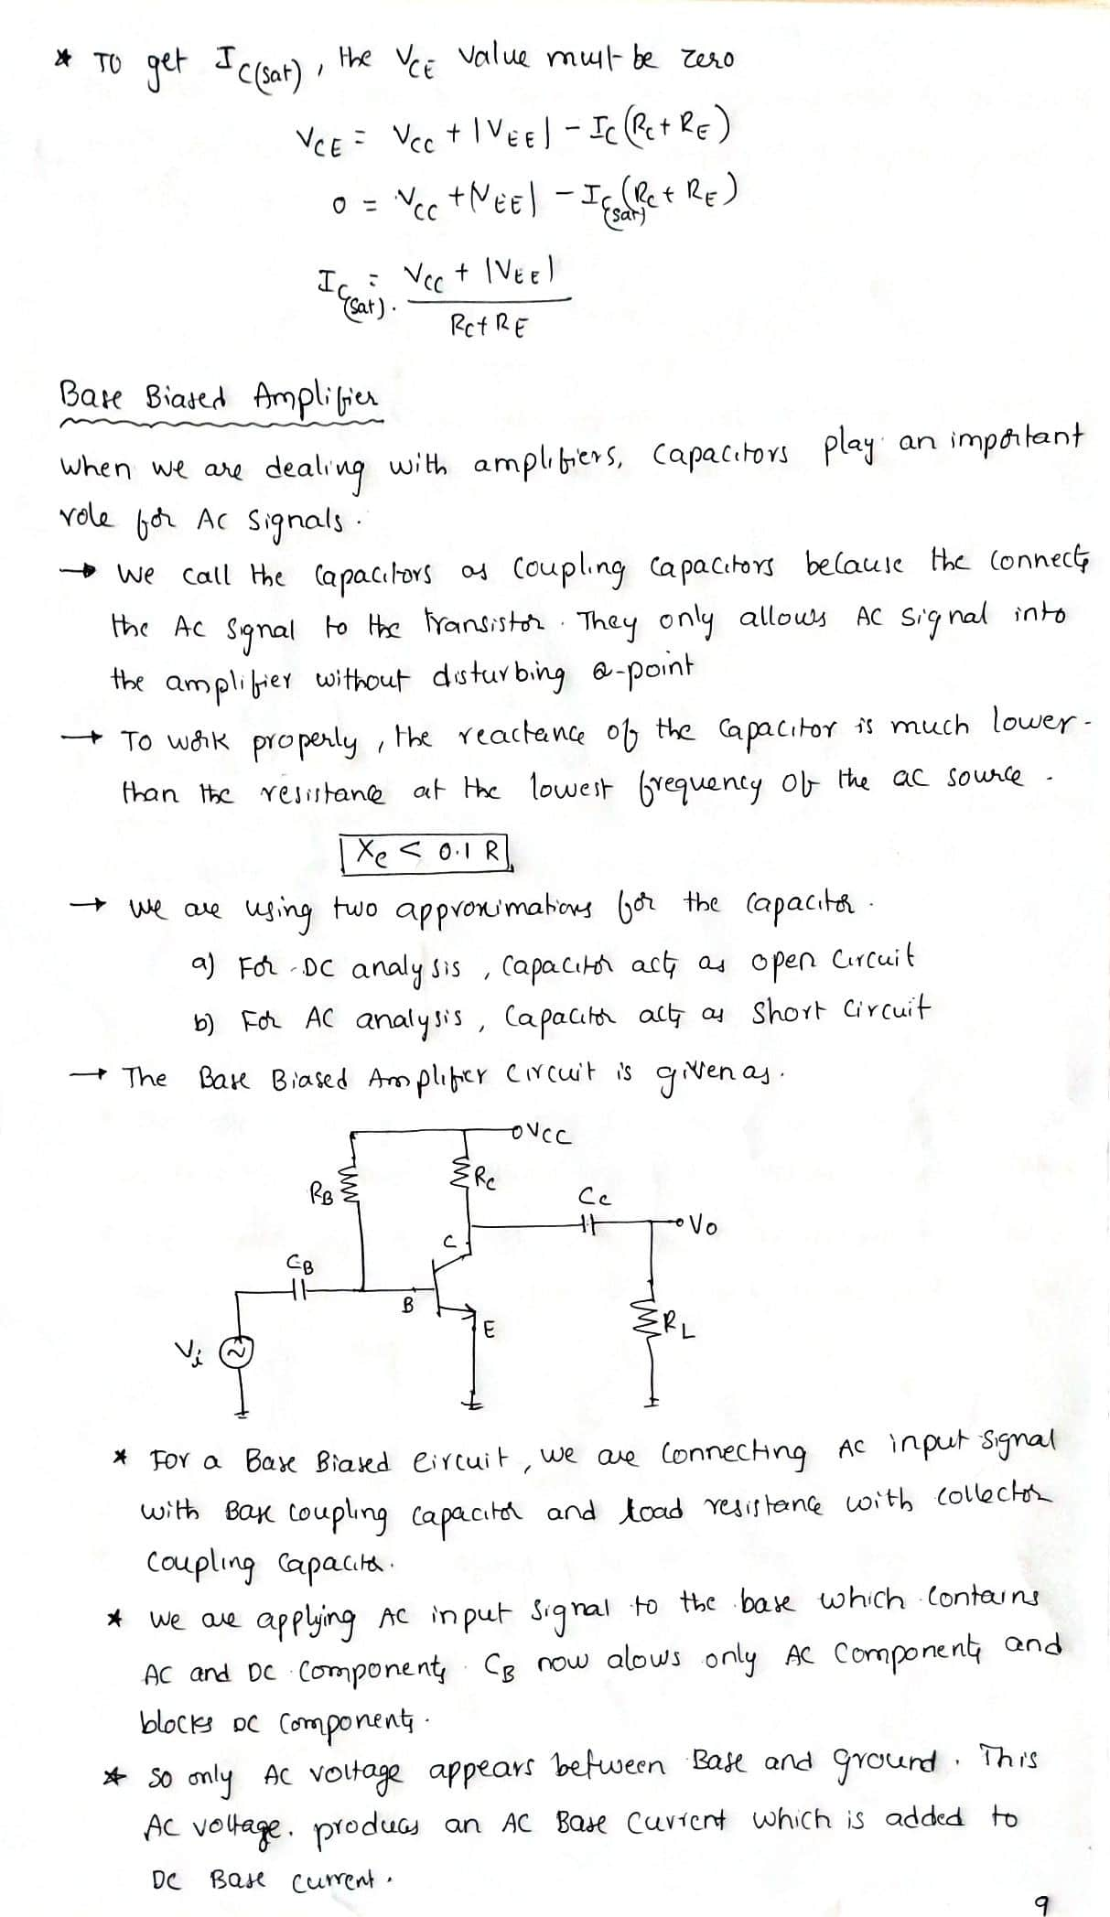

Slide 19
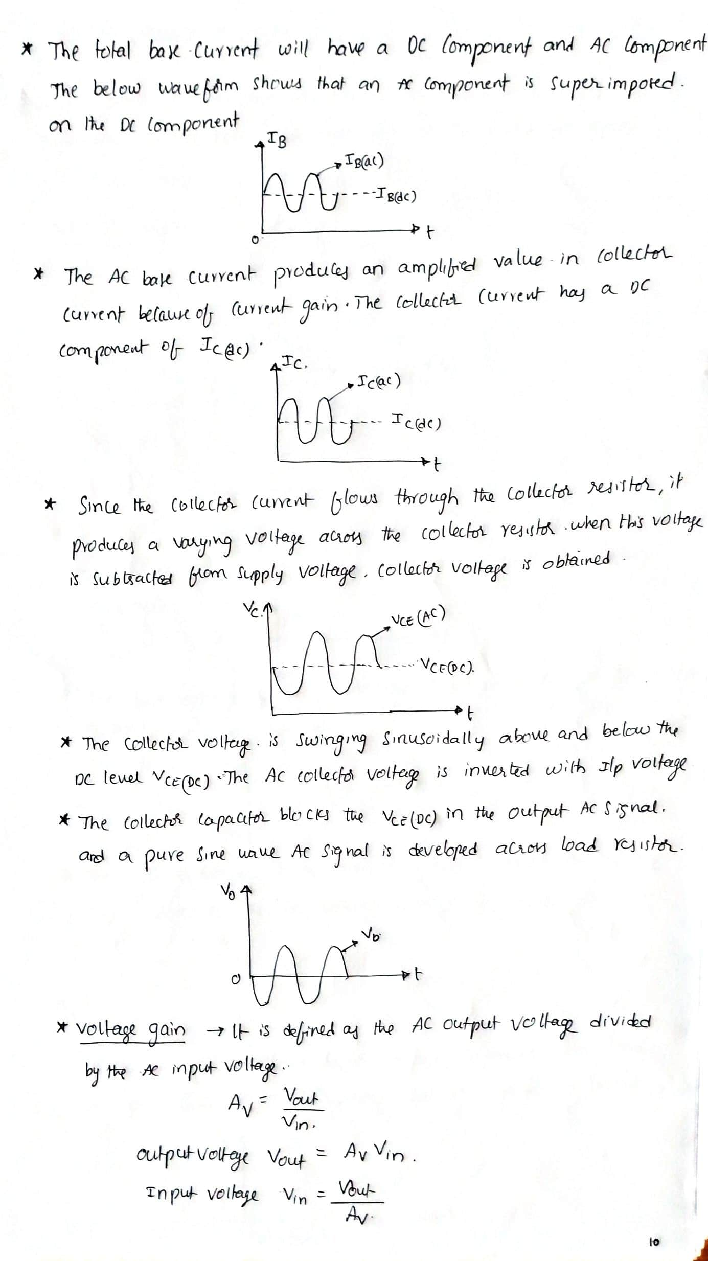

Slide 20
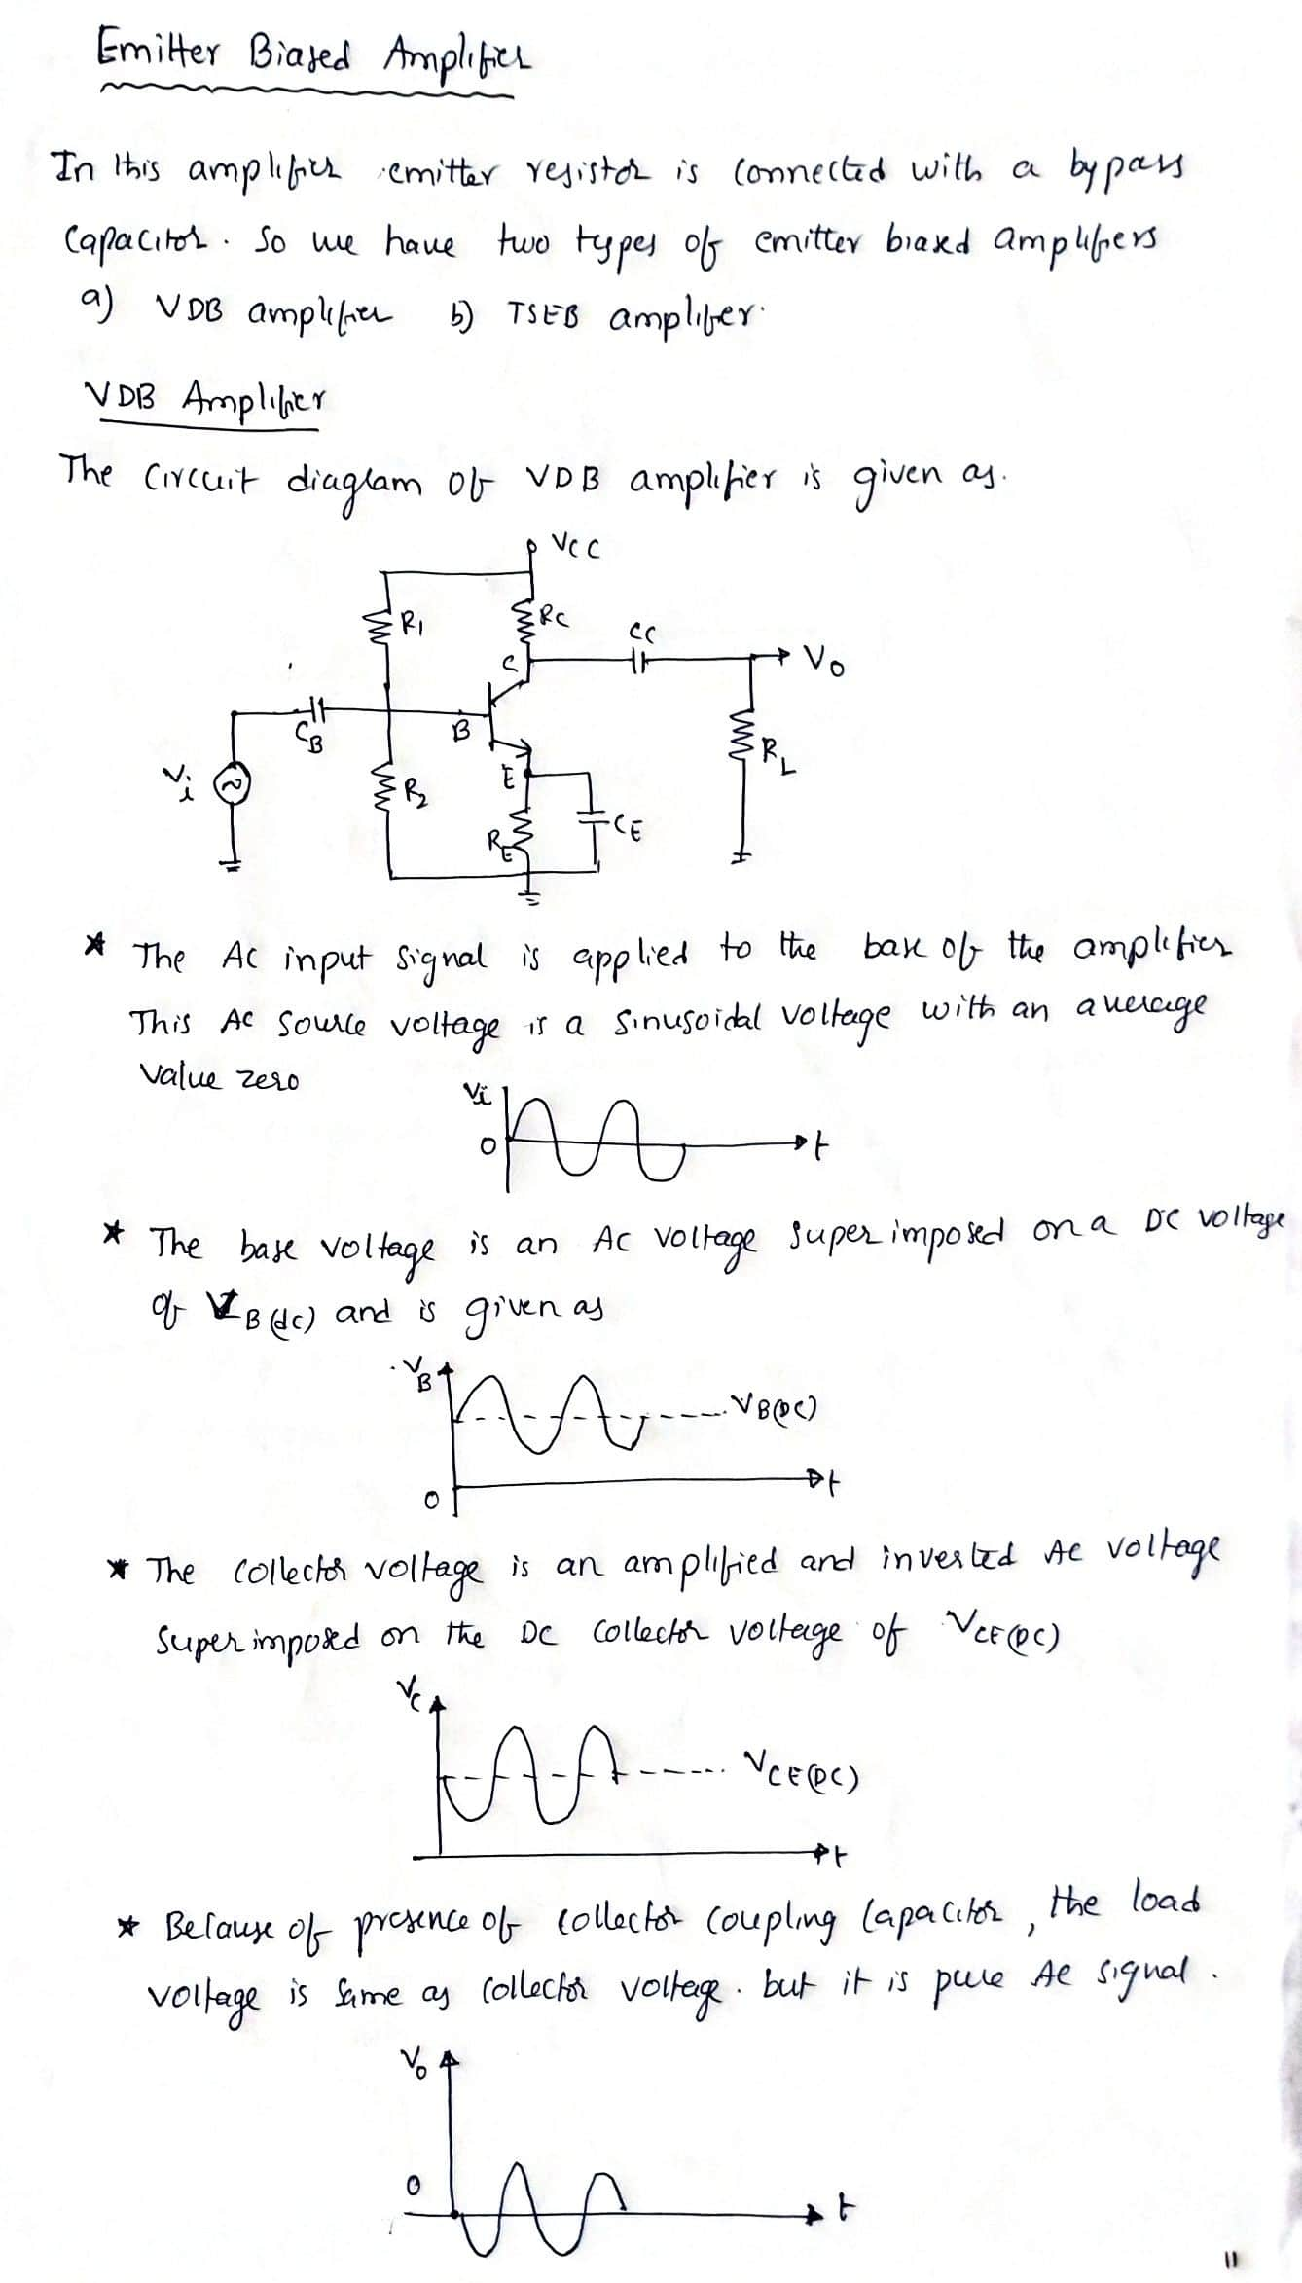

Slide 21
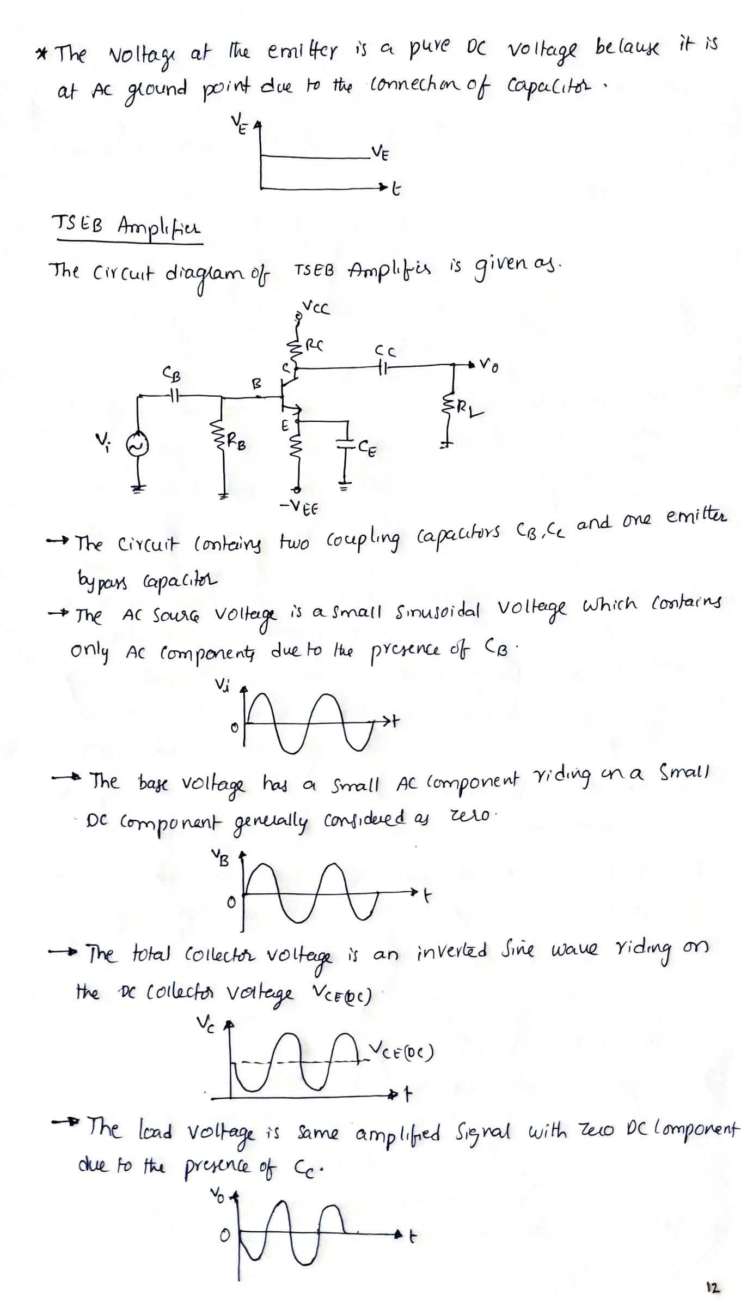

Slide 22
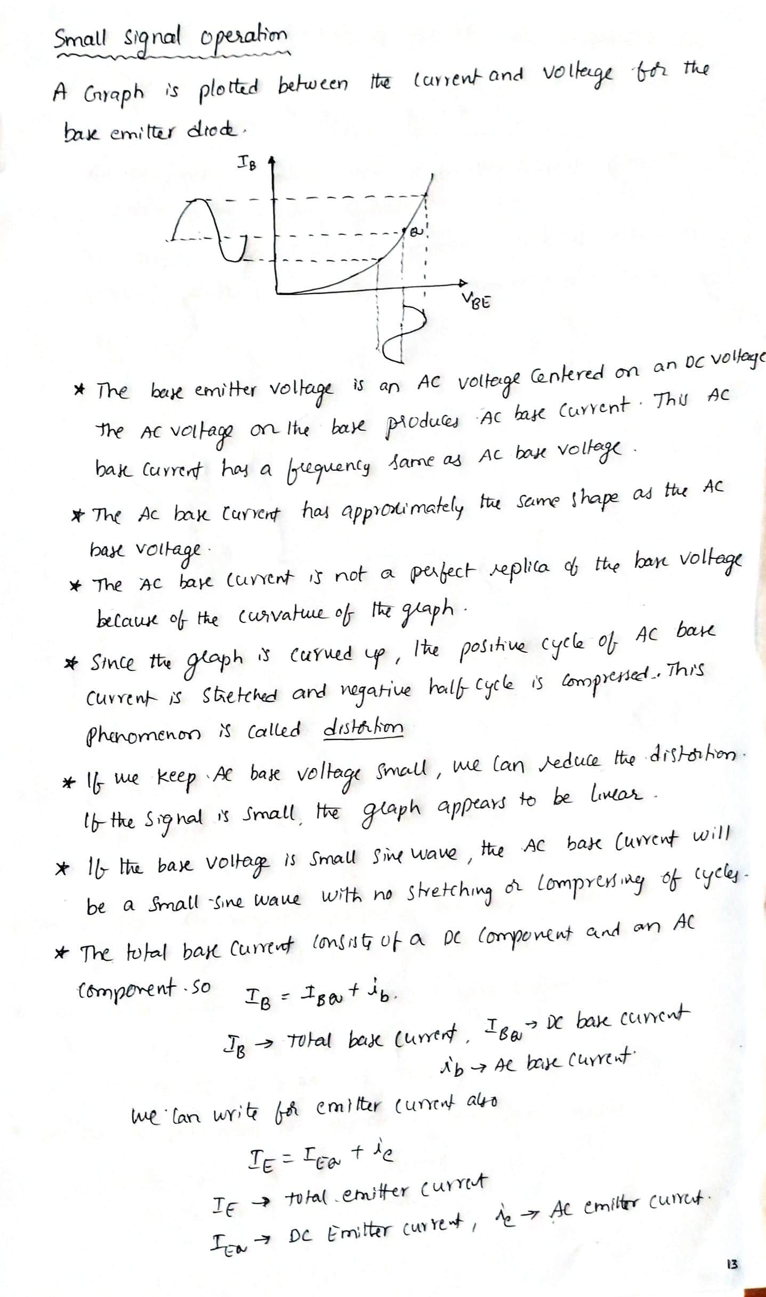

Slide 23
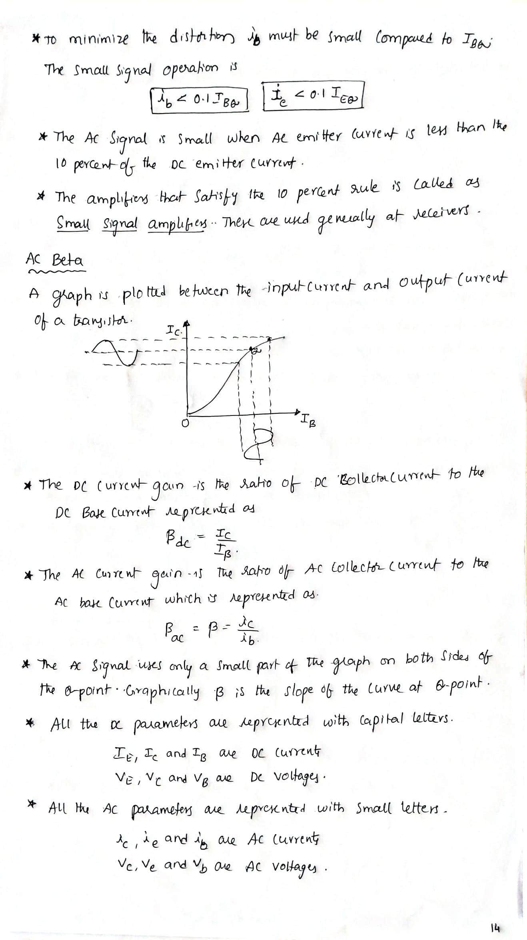

Slide 24
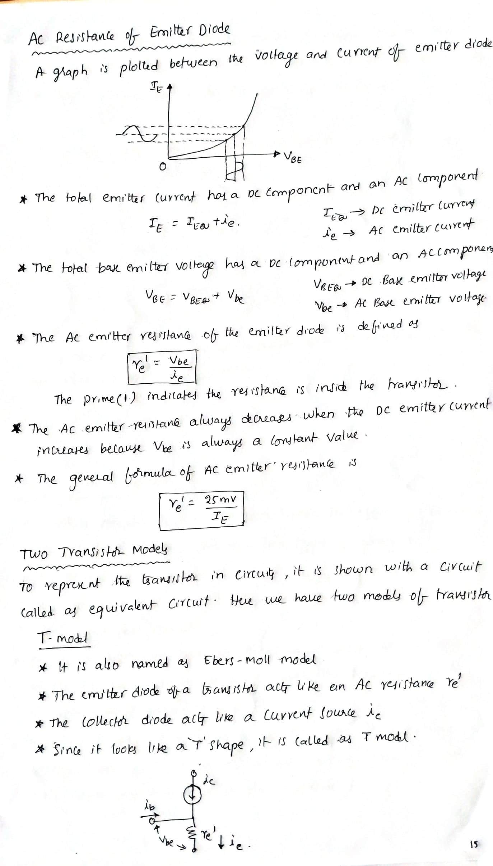

Slide 25






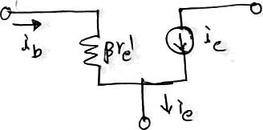


4 t»h n nn c
J›'J « t dfiiVv fin amJ9li $cy
V r› - t
tk 9C ¢,y
4«iilfir vd lJn
** '$*9'Ę '§ Gh='J
hxi nł* {ki tmt ló.i d/n‹:$ , uA haizi
4:1/ze*'^**?I Dł*ł “”^g*Ź" ”mg‹d^*"*
,
*b
*b
wg m(yg°vĘ °Ę n lx^''**° **
To c•«ł),-zą pmy I• {¿cx‹ , we h«uc ł-c C> Ir ulo¥ /Q
ę | e‹y op
p) y „ /y
”* •>”°« °' '•-• •« • ** › •-,
p\Ł l1«
or fOuM*j
'•›6‹A 6
P urxś • +*'t *Y^^t'SM-
's ’°
» ip t i'''• I '› &i.j,.e,; ;J u«:•ę =t•ri« +'h^ry •w r£ rx
RJCtłvn h nĘ- r( ,'J ta‹l I tel pct ÓJ c›l Ci . I tt1<r
n:n r ul- m eder'f+ and Ouh Ł !m

Slide 26
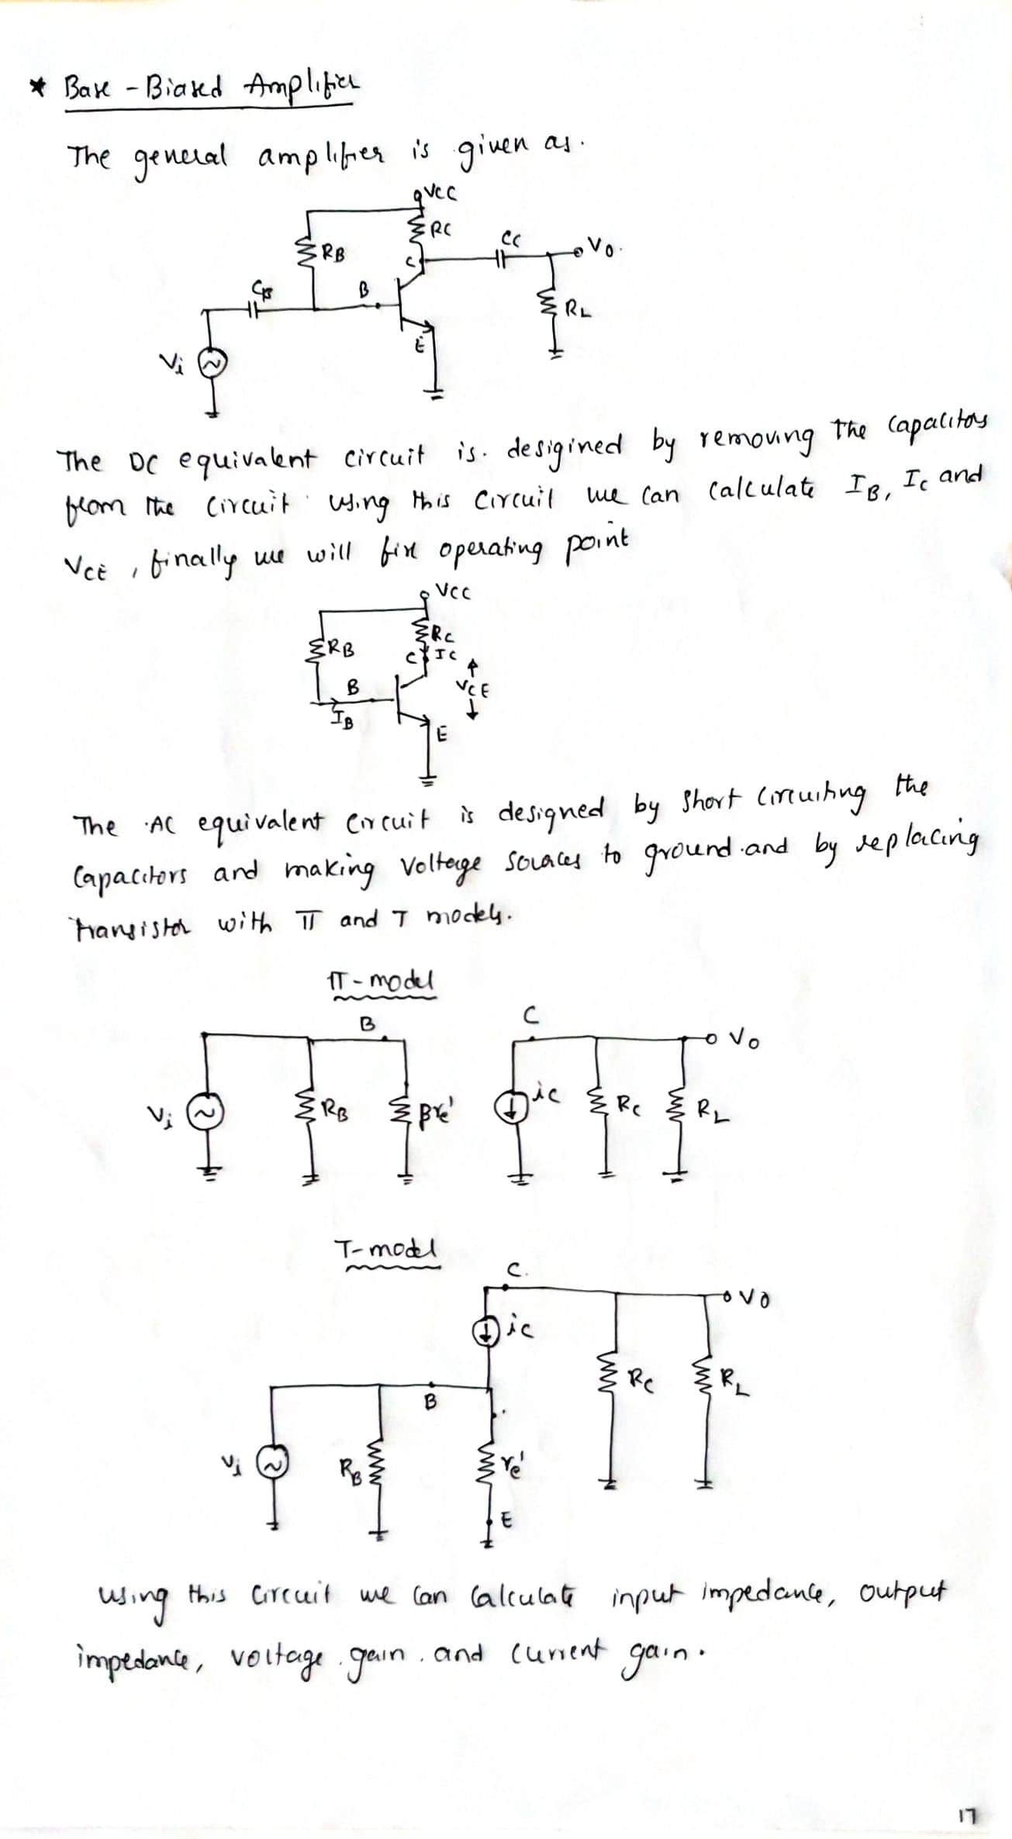

Slide 27
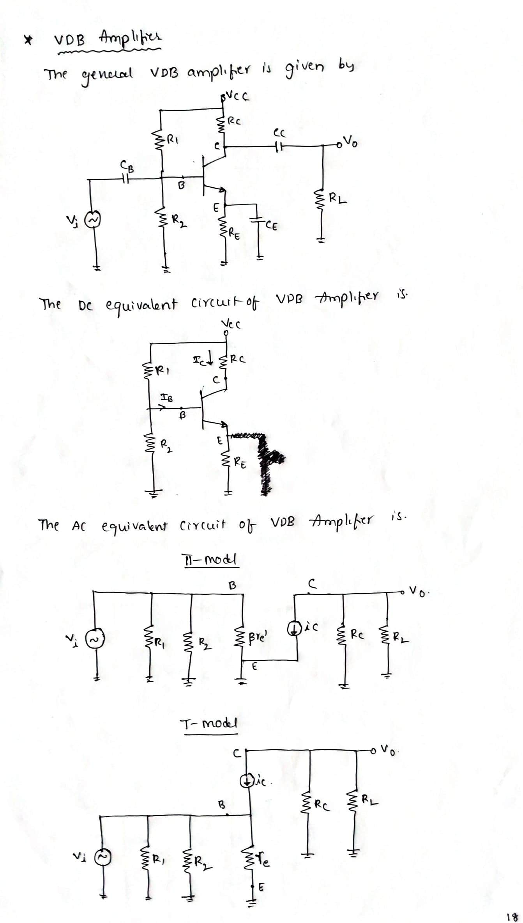

Slide 28
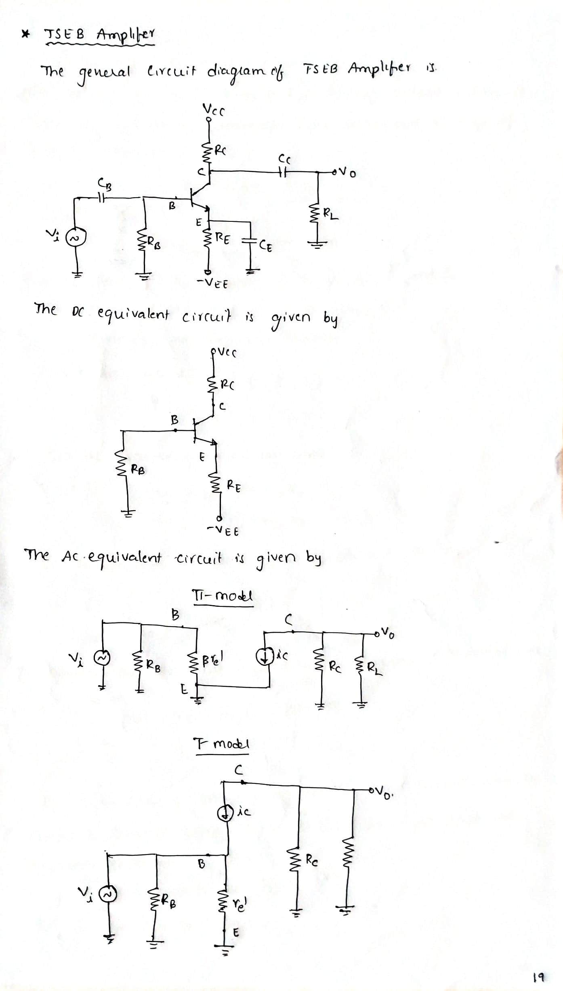

Slide 29


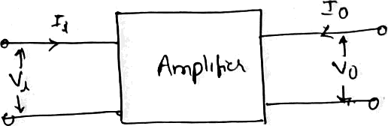
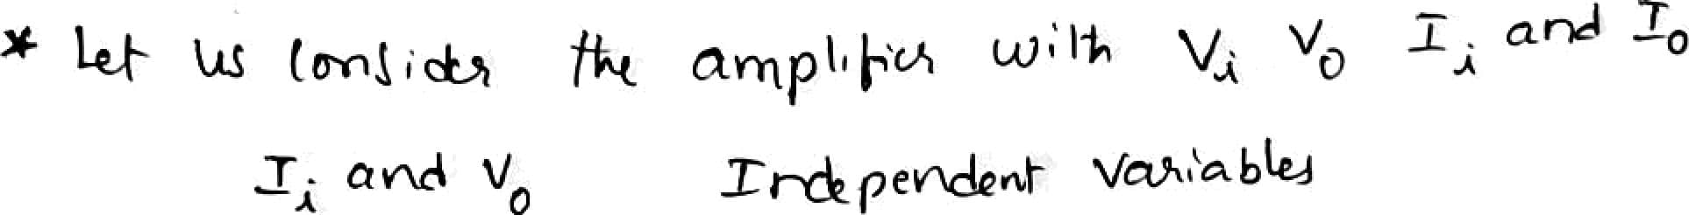








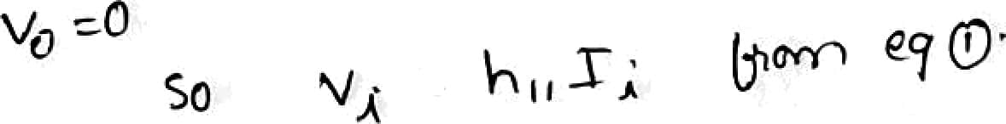



I h í› glțg
čłc*ą ąr i Ï-a-
*¥ WŁù ìn
s, lJy bYîJ y•Axnxekr s.
o//. in(x«j= PŁń°n oná Cu.›• ‹ 4 o(Ț-
Î -vrr\j ¿u/<cwh a › n 4- Acà'm
o°‹’Ț’-"
a Vo
”‘^ń"*z ’'
”
V¿ and I¿ cup @(yn&nf '*’^^‹’*bÀi -
" *"‘ ° v.
r,
f=' *-
I›(*«*•)
> rn lA ëę u°r"n (¡ğ«n
I°'" '*^'° °”
’0
„, pÇ, , A›-n łA mbs«f
e-c¡u+ ‹"*
^'*
* Ag,am, <) g;, s t« r t'tu' '»nd* °°•
°“’
"***'“'
‹a 9hr•i-
y rt•<ba «I łc,;
y
Tîñ fo>«ca1 Ü *** "*°"'”-
,

Slide 30
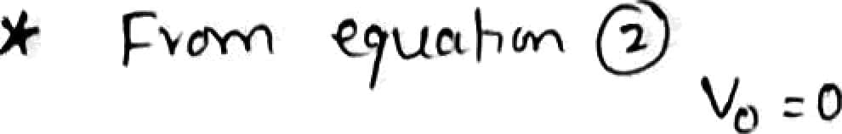

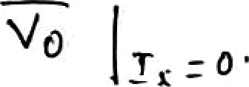
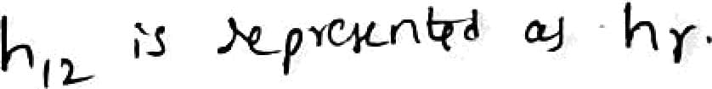
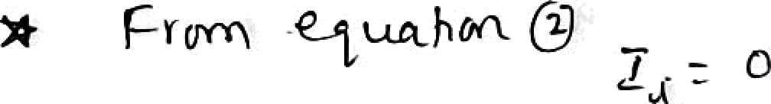


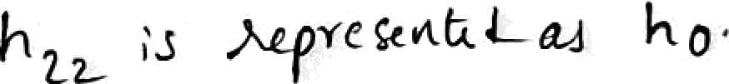
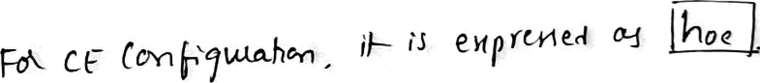
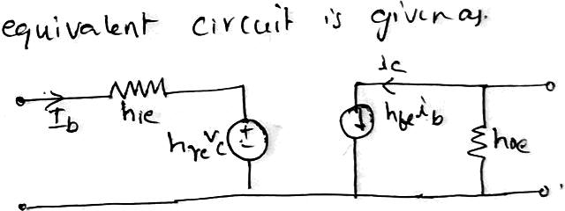
*o
hø, = >•
"ti ‘‹
he, ’s i«t -*•.»• sÇ o «tpur C•»‹.ç- v ftk
owfiW ÿoif- í› śho‹t- r»cc•itr1 so îr '‹ «IM
i«Jxr t >›' «^t ui«p
at •F
F-<r‹ ‹ r
‹o•|/- șu«»-h‹r›
•’r ›’‹
ź|‹v<rt ou
Íń”””” *9'••-*•<• Õ
înț^r srtń>-* .s o(en c‹rru.É«
sd : F- rj c<dk‹ a«
&v‹•x U°!ț•›ìf• '°'°
'ny‹x- 6xi‹w ›s oyin ‹'-rt*łr/
so 'b :s t•*ki "ø °••țp+” +* ' *

Slide 31
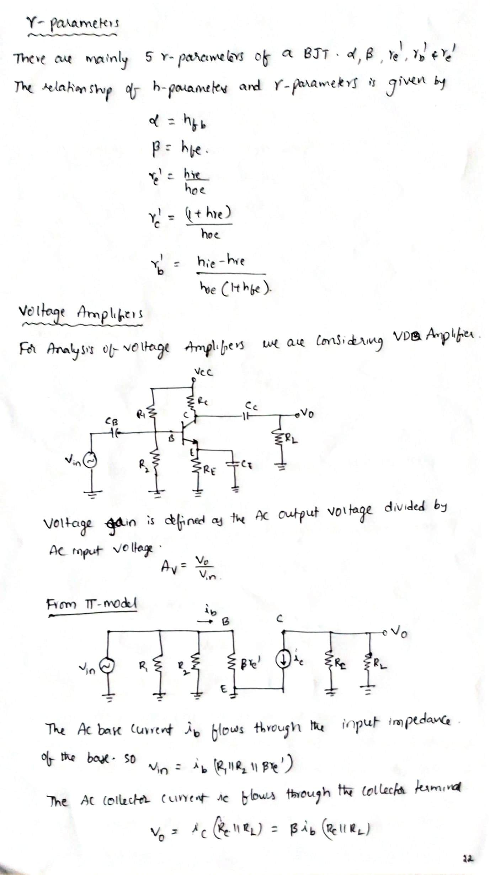

Slide 32
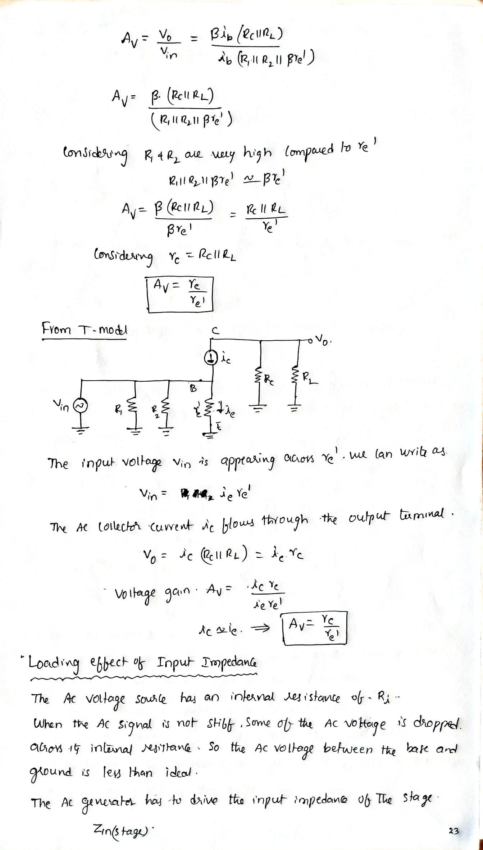

Slide 33
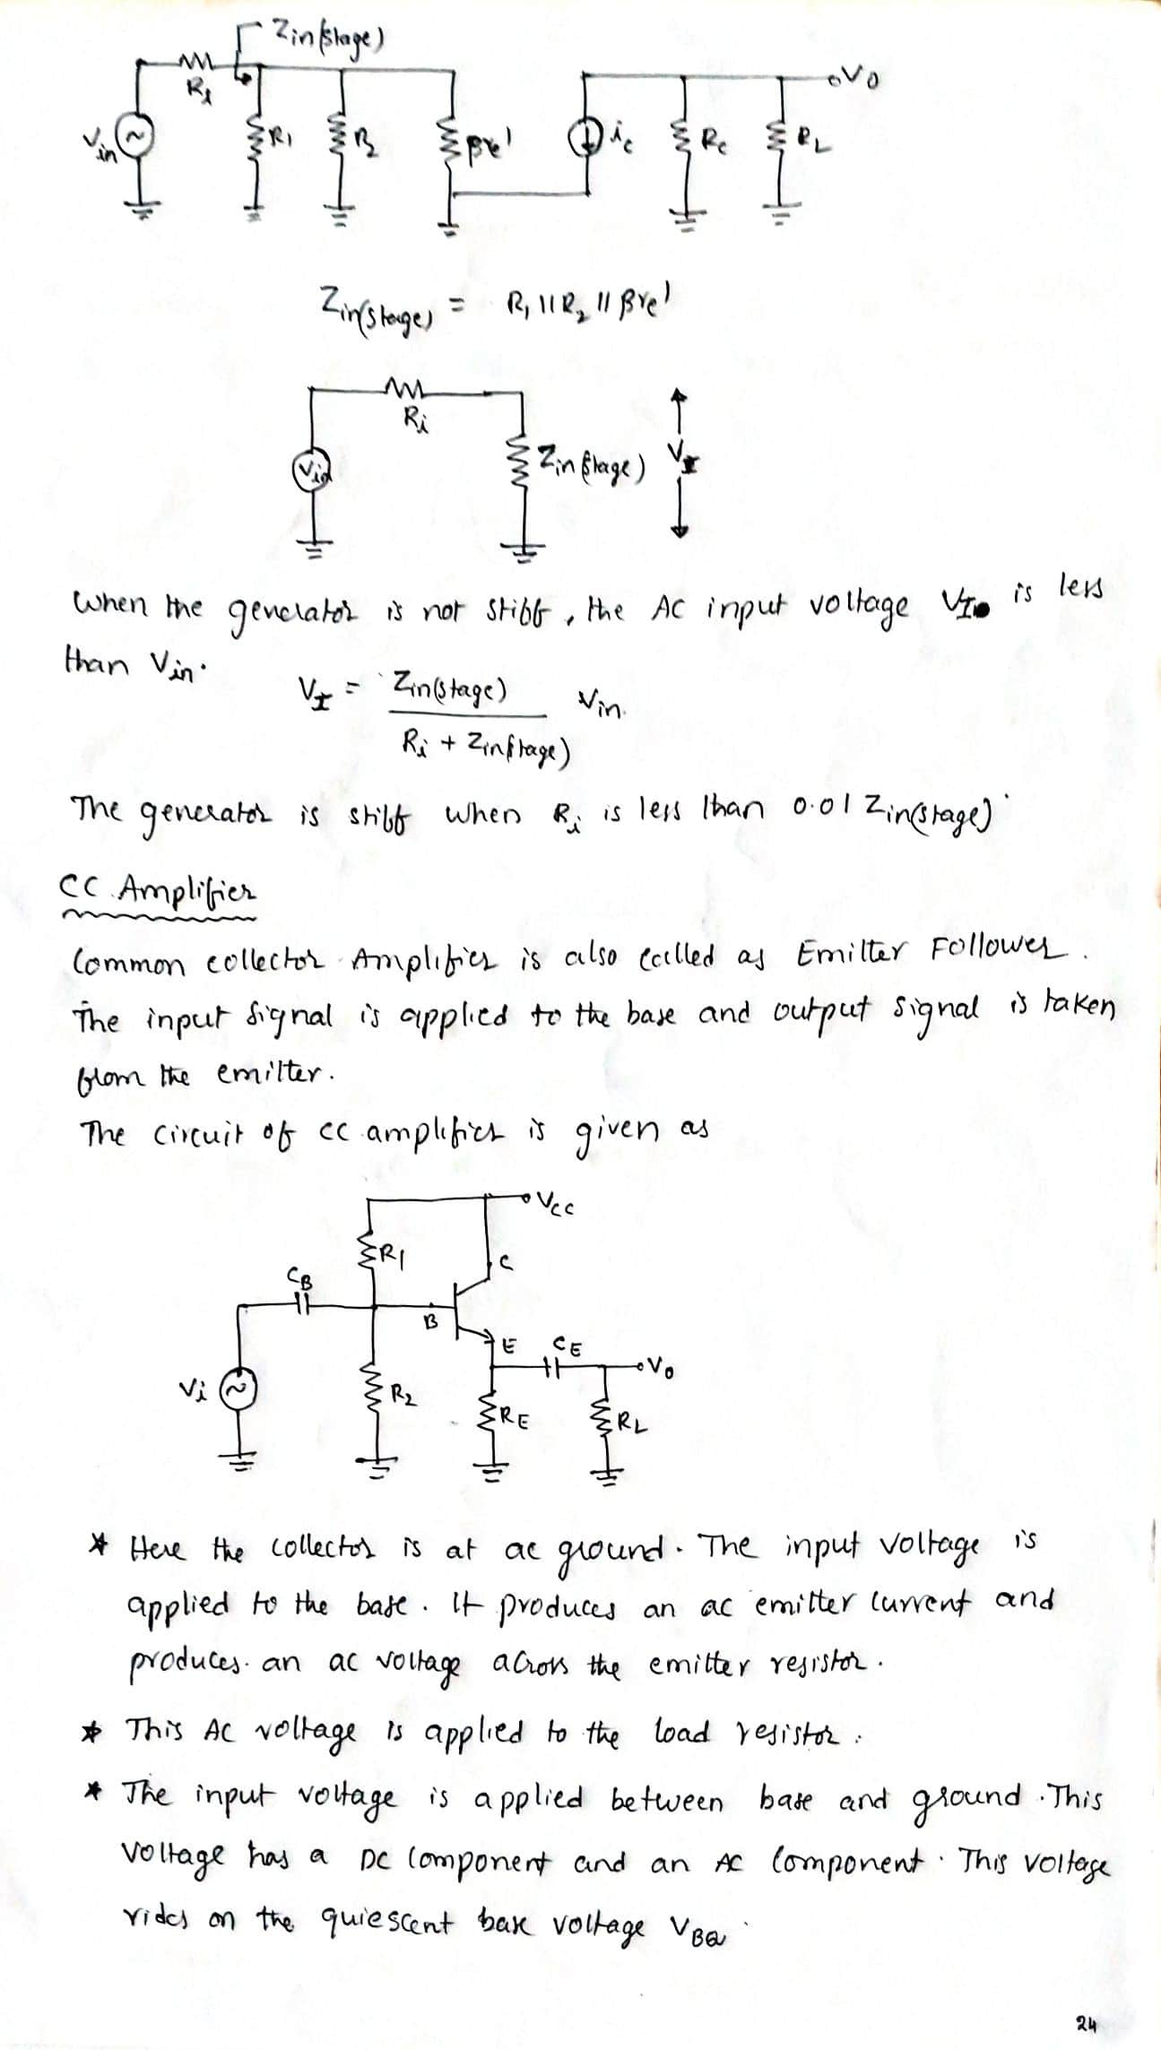

Slide 34
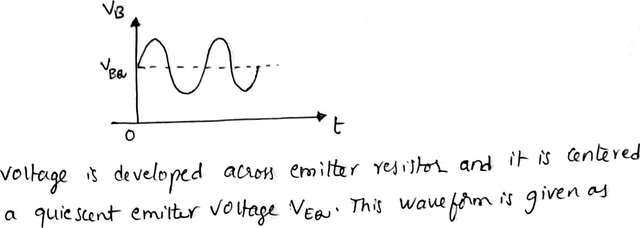
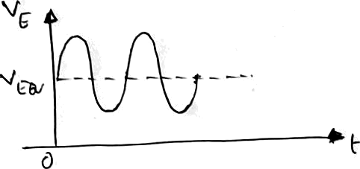
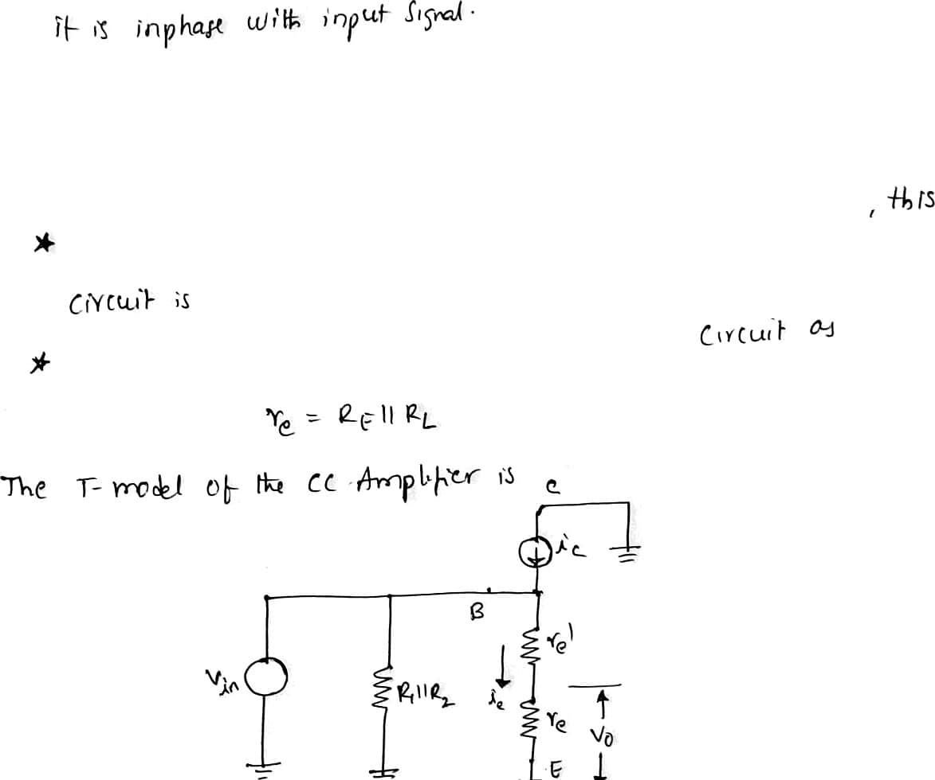
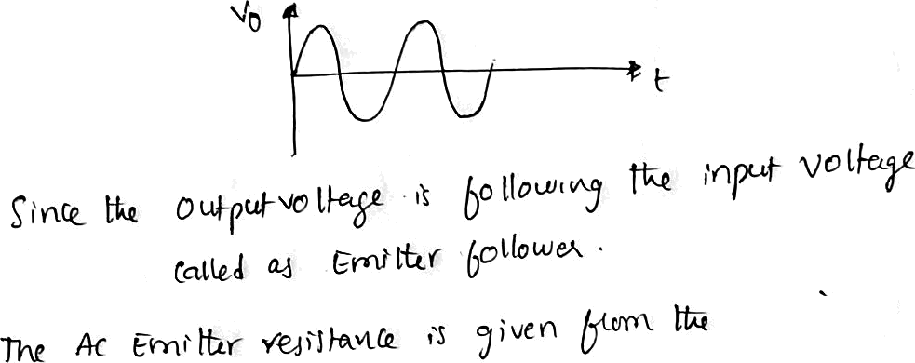




in
*e*'

Slide 35
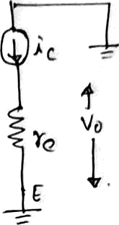
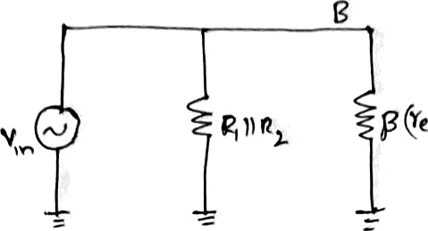

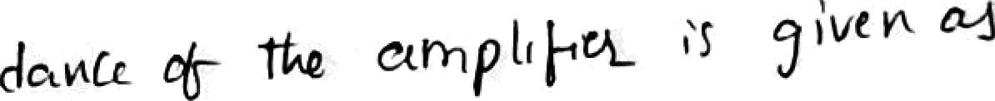
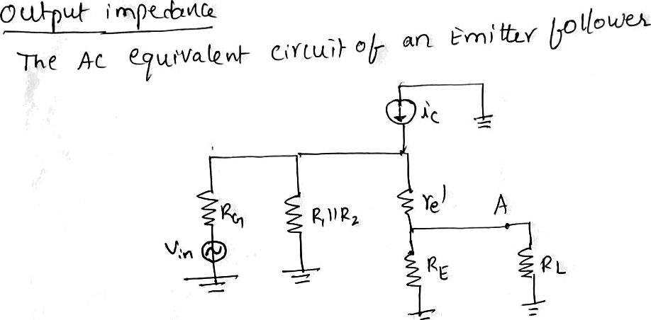
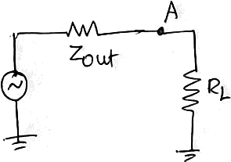


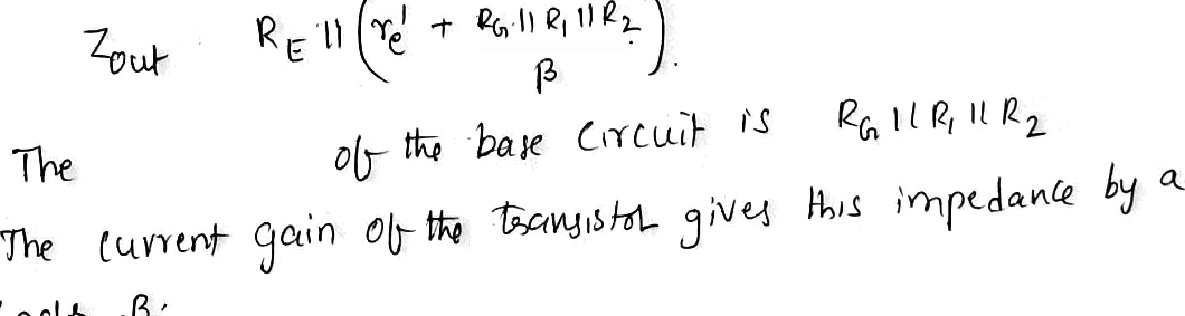

Ą-șyt) *y
Țh6v* n'nù 1ed'eYt =ł P'“ł}"‘*Ç°'”'*
s * ”"°“ .
..à «.*.Q ° °’° ° ^ ” “’"
q jp-Ț
vo tí>g« í '*x 7ouț ^'° ^ * L
•« t.n &i*° »°* ^ '•’ s
! «i

Slide 36
